Slide 1


Campaign Summary
Southeastern Grocers – Winn Dixie & Harvey’s Black Friday Campaign
Budget Allocation
50%, Proportional Based on Store Sales
50%, Proportional Based on Known Transactions
Green, Amber, Red impact
Green = -10%
Amber = Neutral
Red = +10%
Current Customer vs Conquest Customer budget ratio
Green = 50% Current Customers, 50% Conquest Customers
Amber = 60% Current Customers, 40% Conquest Customers
Red = 70% Current Customers, 30% Conquest Customers
Number of weeks: 5 weeks
From 11/28/2025 to 12/31/2025
Participating stores: 136 stores
Red Stores: 37 Stores
Amber Stores: 49 Stores
Green Stores: 37 Stores
Ungrouped Stores: 8 Stores
Harvey’s Stores: 9 Stores
Media Spend: $400,000 total budget
$79,999.99 per week

Slide 2
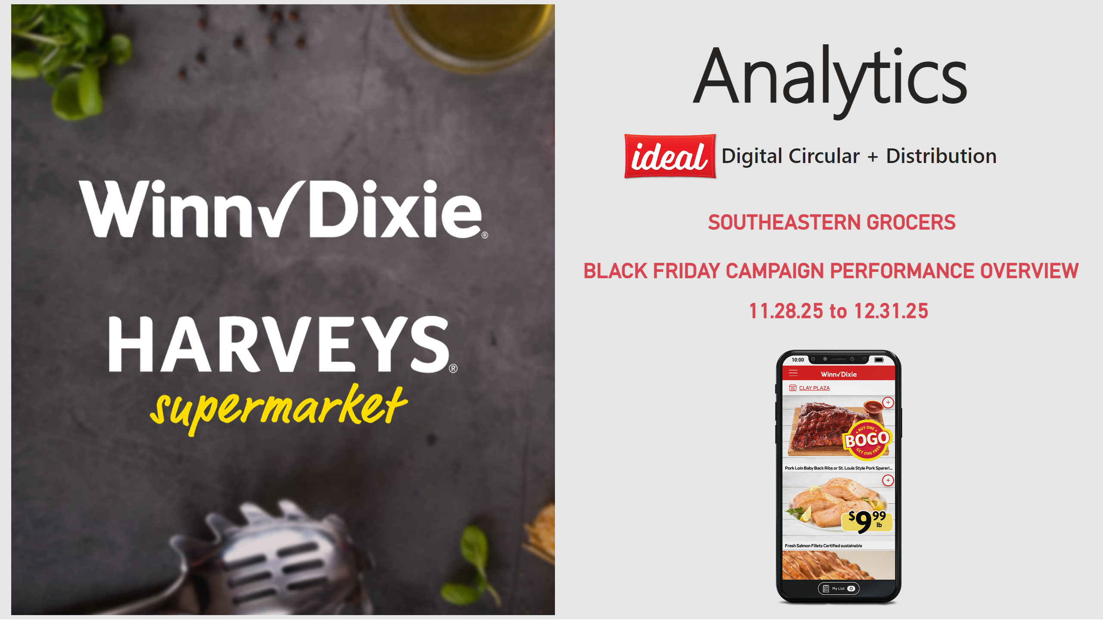
Cover
Notes:
shape
No alt text provided
Analytics Title
No alt text provided
Ad. Card Quarterly
No alt text provided
Ad. Card Quarterly
No alt text provided
Image - Ideal
No alt text provided
slicer
No alt text provided
shape
No alt text provided
slicer
No alt text provided
slicer
No alt text provided
Image - Ideal
No alt text provided
Ad. Card Digital Circular
No alt text provided
image
No alt text provided
image
No alt text provided
Ad. Card Quarterly
No alt text provided

Slide 3
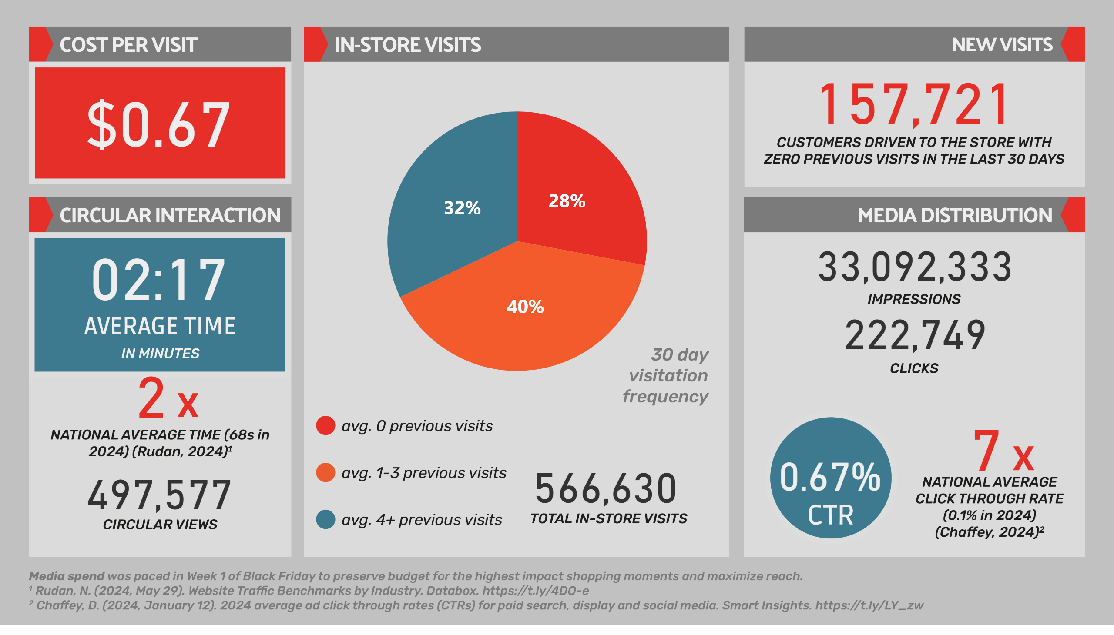
Analytics 2
Notes:
Ad. Card - CPV
No alt text provided
Pie Chart - VF
No alt text provided
Ad. Card - Visits
No alt text provided
Ad. Card - Time X
No alt text provided
Ad. Card - Views
No alt text provided
Ad. Card - Minutes
No alt text provided
Ad. Card - Clicks
No alt text provided
Ad. Card - Impressions
No alt text provided
Ad. Card - CTR
No alt text provided
Ad. Card - CTR X
No alt text provided
cardVisual
No alt text provided
cardVisual
No alt text provided
image
No alt text provided
slicer
No alt text provided
slicer
No alt text provided
slicer
No alt text provided
image
No alt text provided
Ad. Card - New Visits
No alt text provided

Slide 4
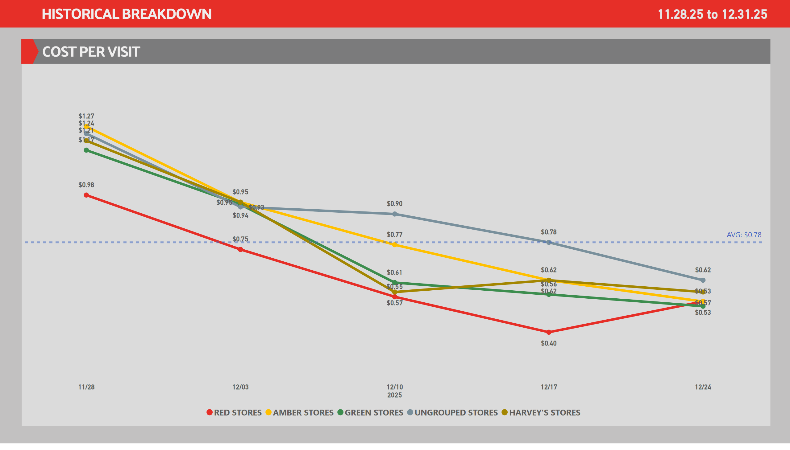
CPV's
Notes:
shape
No alt text provided
lineChart
No alt text provided
lineChart
No alt text provided
Ad. Card - Demo Period
No alt text provided
Line Chart - CPV
No alt text provided
slicer
No alt text provided
slicer
No alt text provided

Slide 5
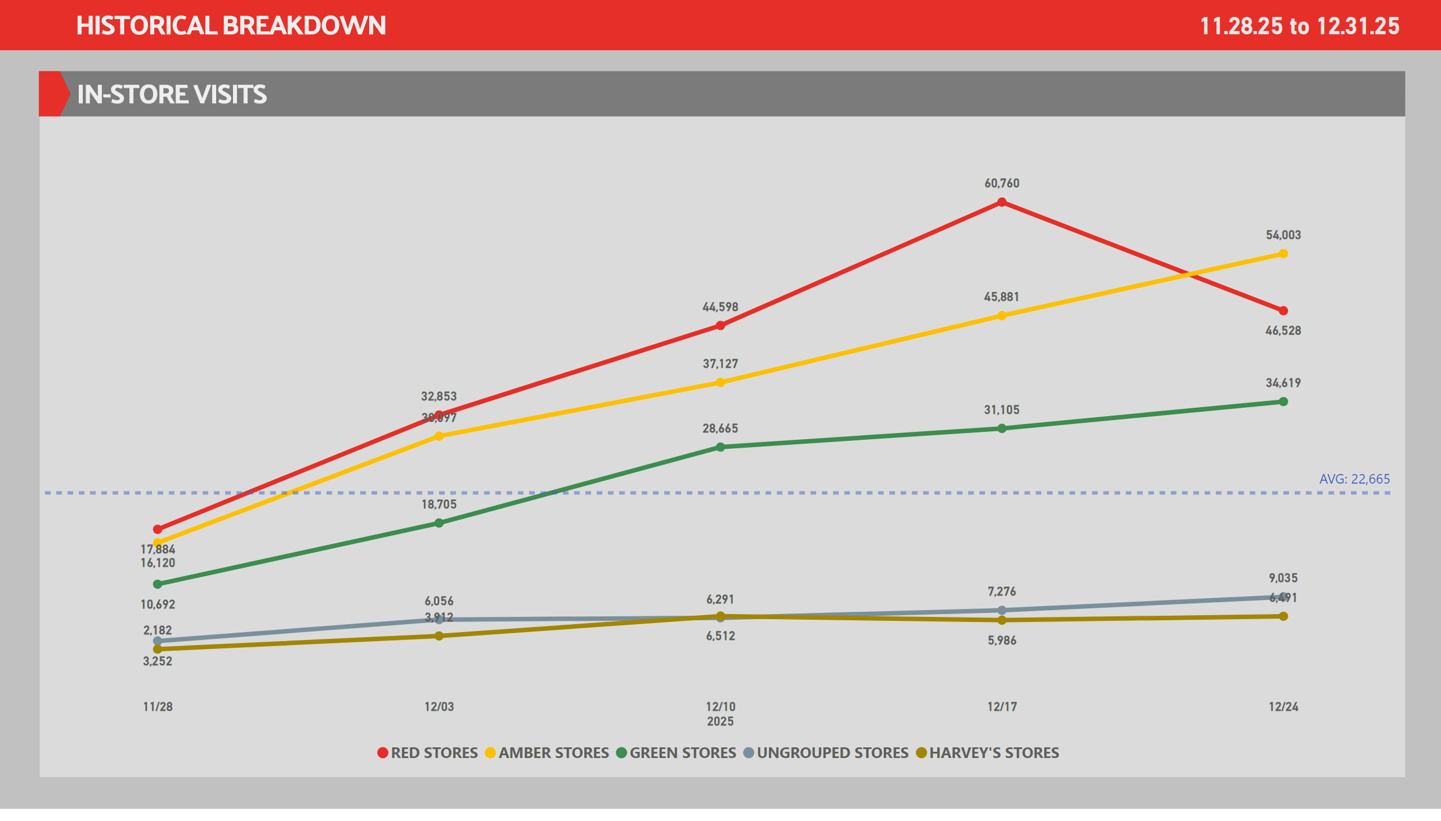
Visits
Notes:
lineChart
No alt text provided
lineChart
No alt text provided
Ad. Card - Demo Period
No alt text provided
Line Chart - Visits
No alt text provided
slicer
No alt text provided
slicer
No alt text provided

Slide 6
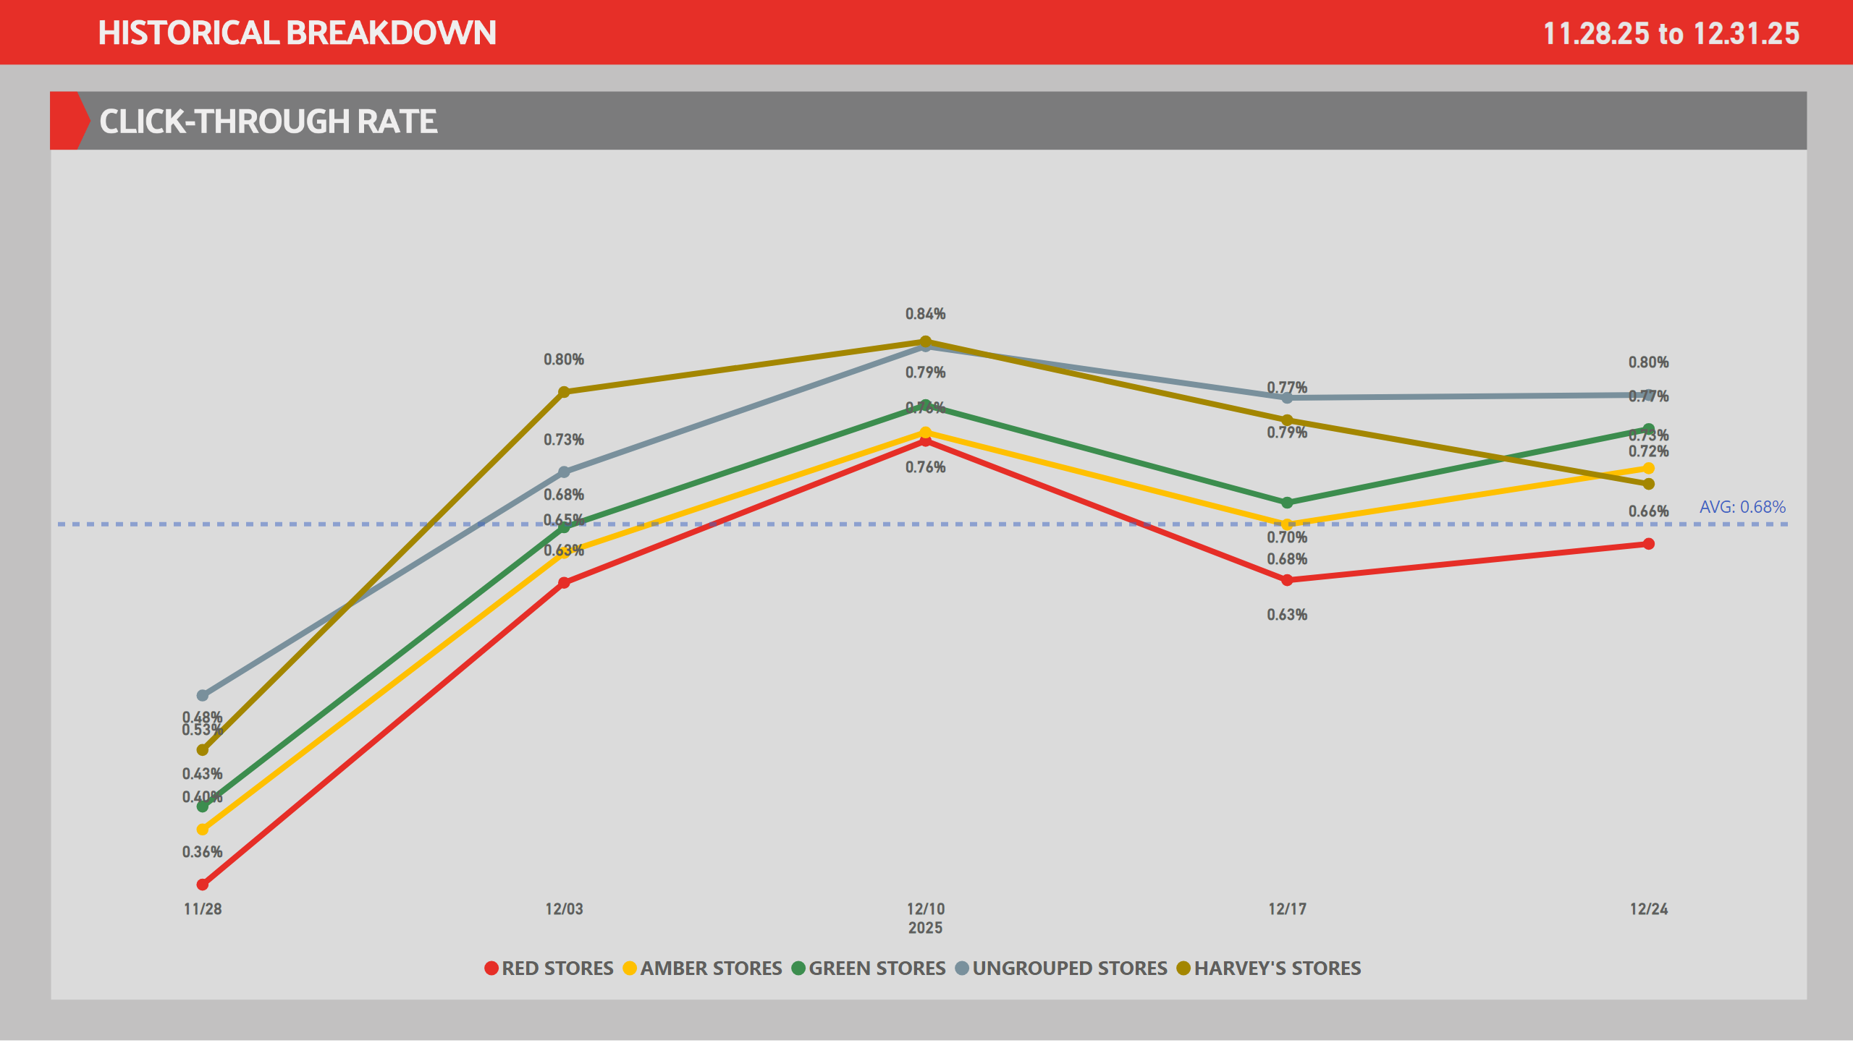
CTR
Notes:
lineChart
No alt text provided
lineChart
No alt text provided
Ad. Card - Demo Period
No alt text provided
Line Chart - CTR
No alt text provided
slicer
No alt text provided
slicer
No alt text provided

Slide 7
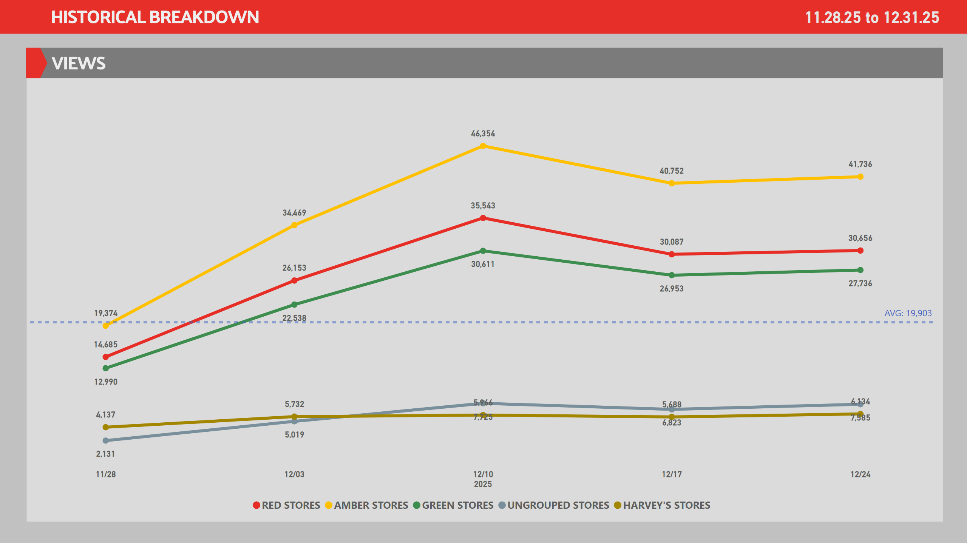
Views
Notes:
lineChart
No alt text provided
lineChart
No alt text provided
Ad. Card - Demo Period
No alt text provided
Line Chart - Views
No alt text provided
slicer
No alt text provided
slicer
No alt text provided

Slide 8
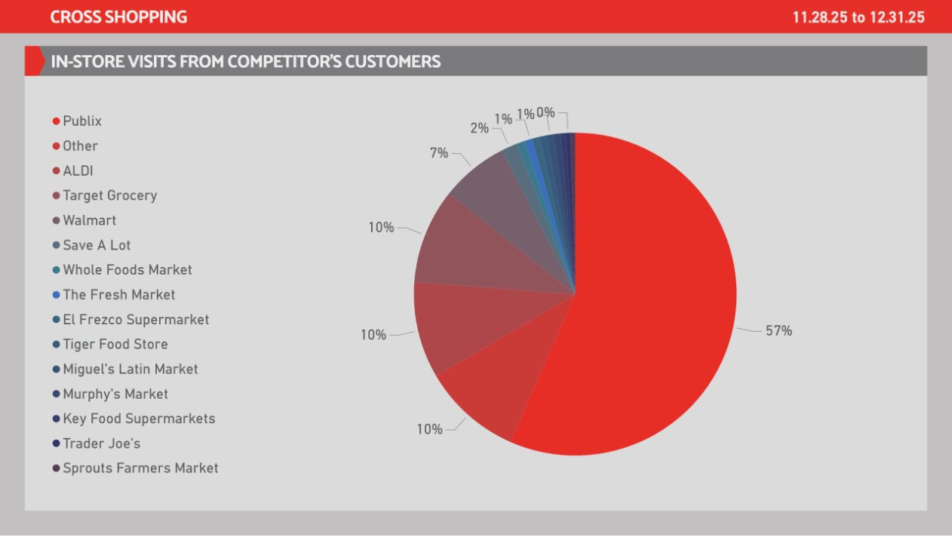
Competitors 01
Notes:
Ad. Card - Demo Period
No alt text provided
slicer
No alt text provided
shape
No alt text provided
slicer
No alt text provided
slicer
No alt text provided
Matrix - Store Breakdown
No alt text provided

Slide 9
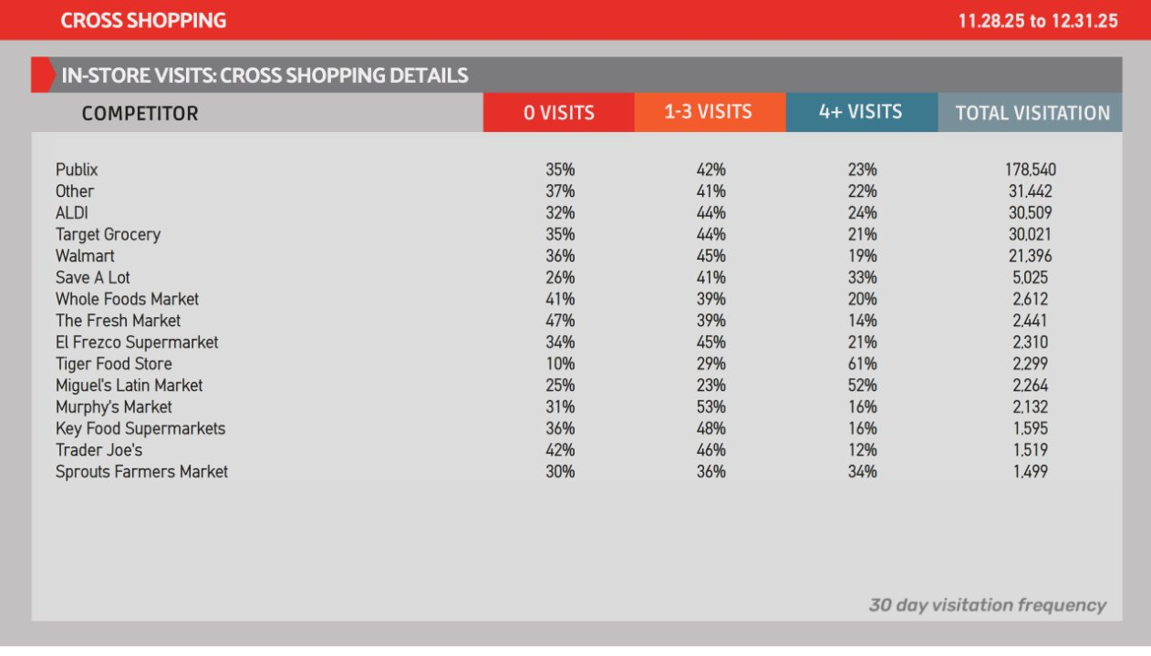
Competitors 02
Notes:
Ad. Card - Demo Period
No alt text provided
slicer
No alt text provided
image
No alt text provided
slicer
No alt text provided
slicer
No alt text provided
pivotTable
No alt text provided

Slide 10
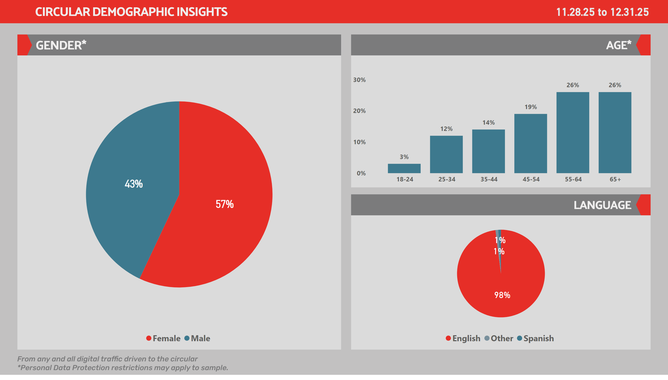
Demo 01
Notes:
Pie Chart - Gender
No alt text provided
Column Chart - Age
No alt text provided
Pie Chart - Language
No alt text provided
Ad. Card - Demo Period
No alt text provided
slicer
No alt text provided

Slide 11
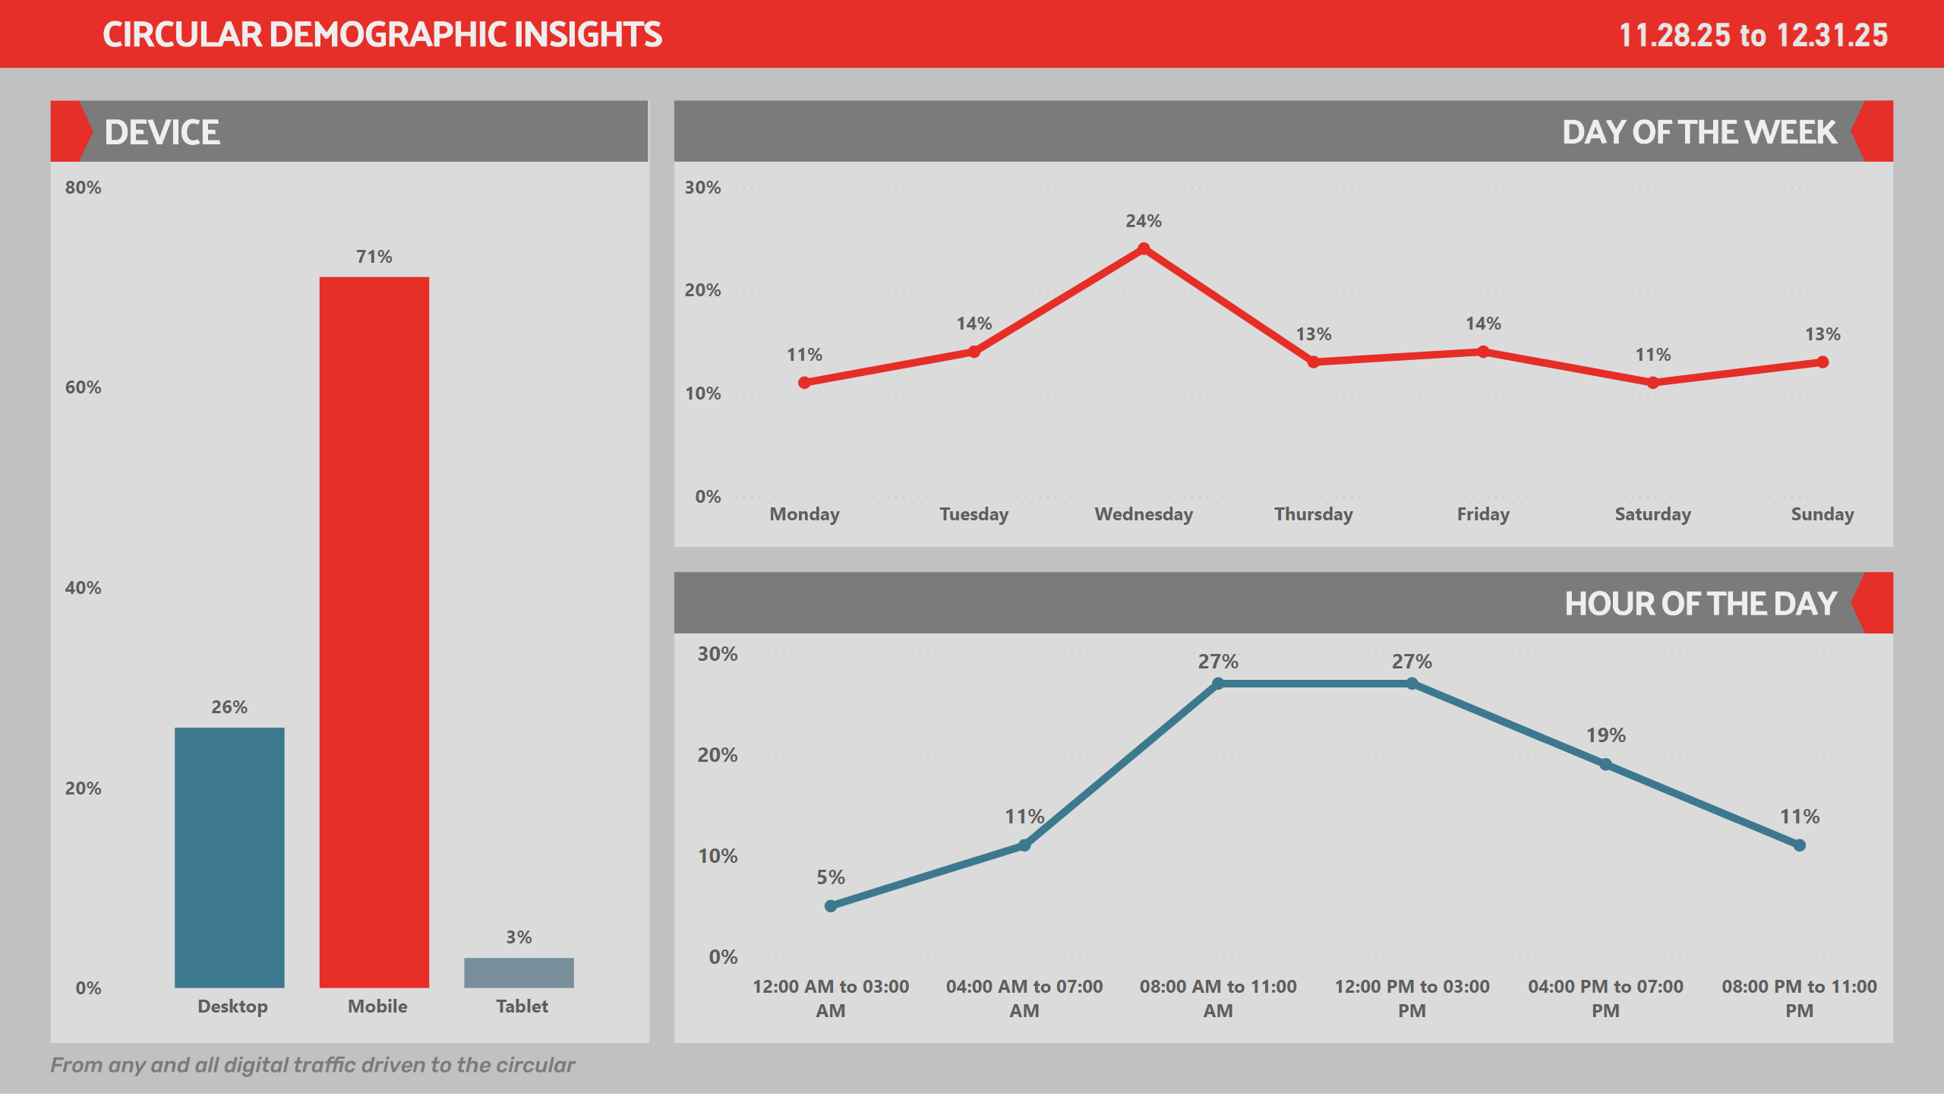
Demo 02
Notes:
Ad. Card - Demo Period
No alt text provided
Line Chart - Time Bins
No alt text provided
Line Chart - Week
No alt text provided
Column Chart - Device
No alt text provided
slicer
No alt text provided

Slide 12
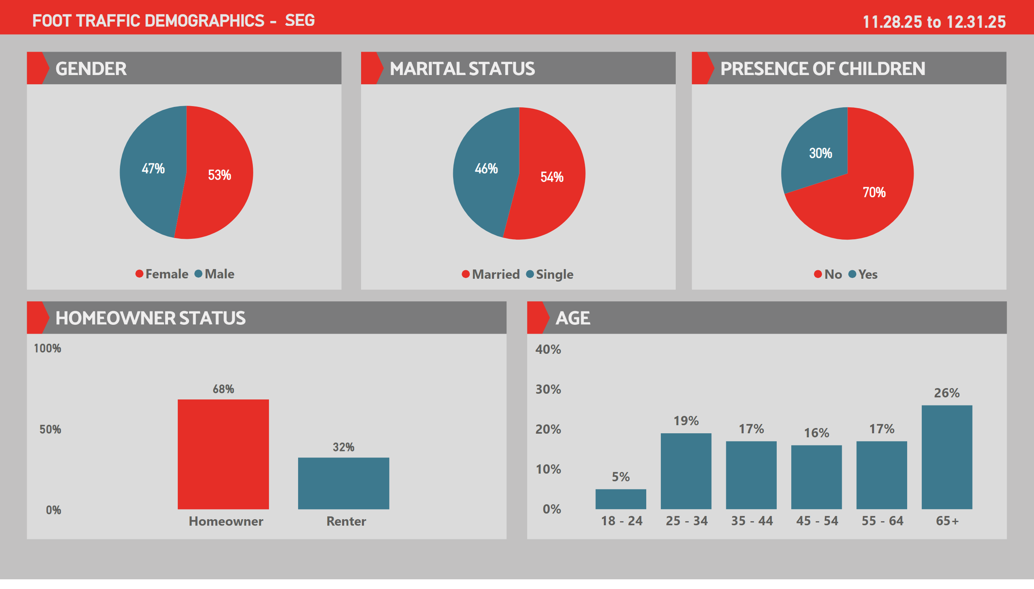
DSEG1
Notes:
cardVisual
No alt text provided
Ad. Card - Demo Period
No alt text provided
Ad. Card - Demo Period
No alt text provided
cardVisual
No alt text provided
Pie Chart - Gender
No alt text provided
Pie Chart - Language
No alt text provided
Pie Chart - Language
No alt text provided
Column Chart - Device
No alt text provided
Column Chart - Age
No alt text provided

Slide 13
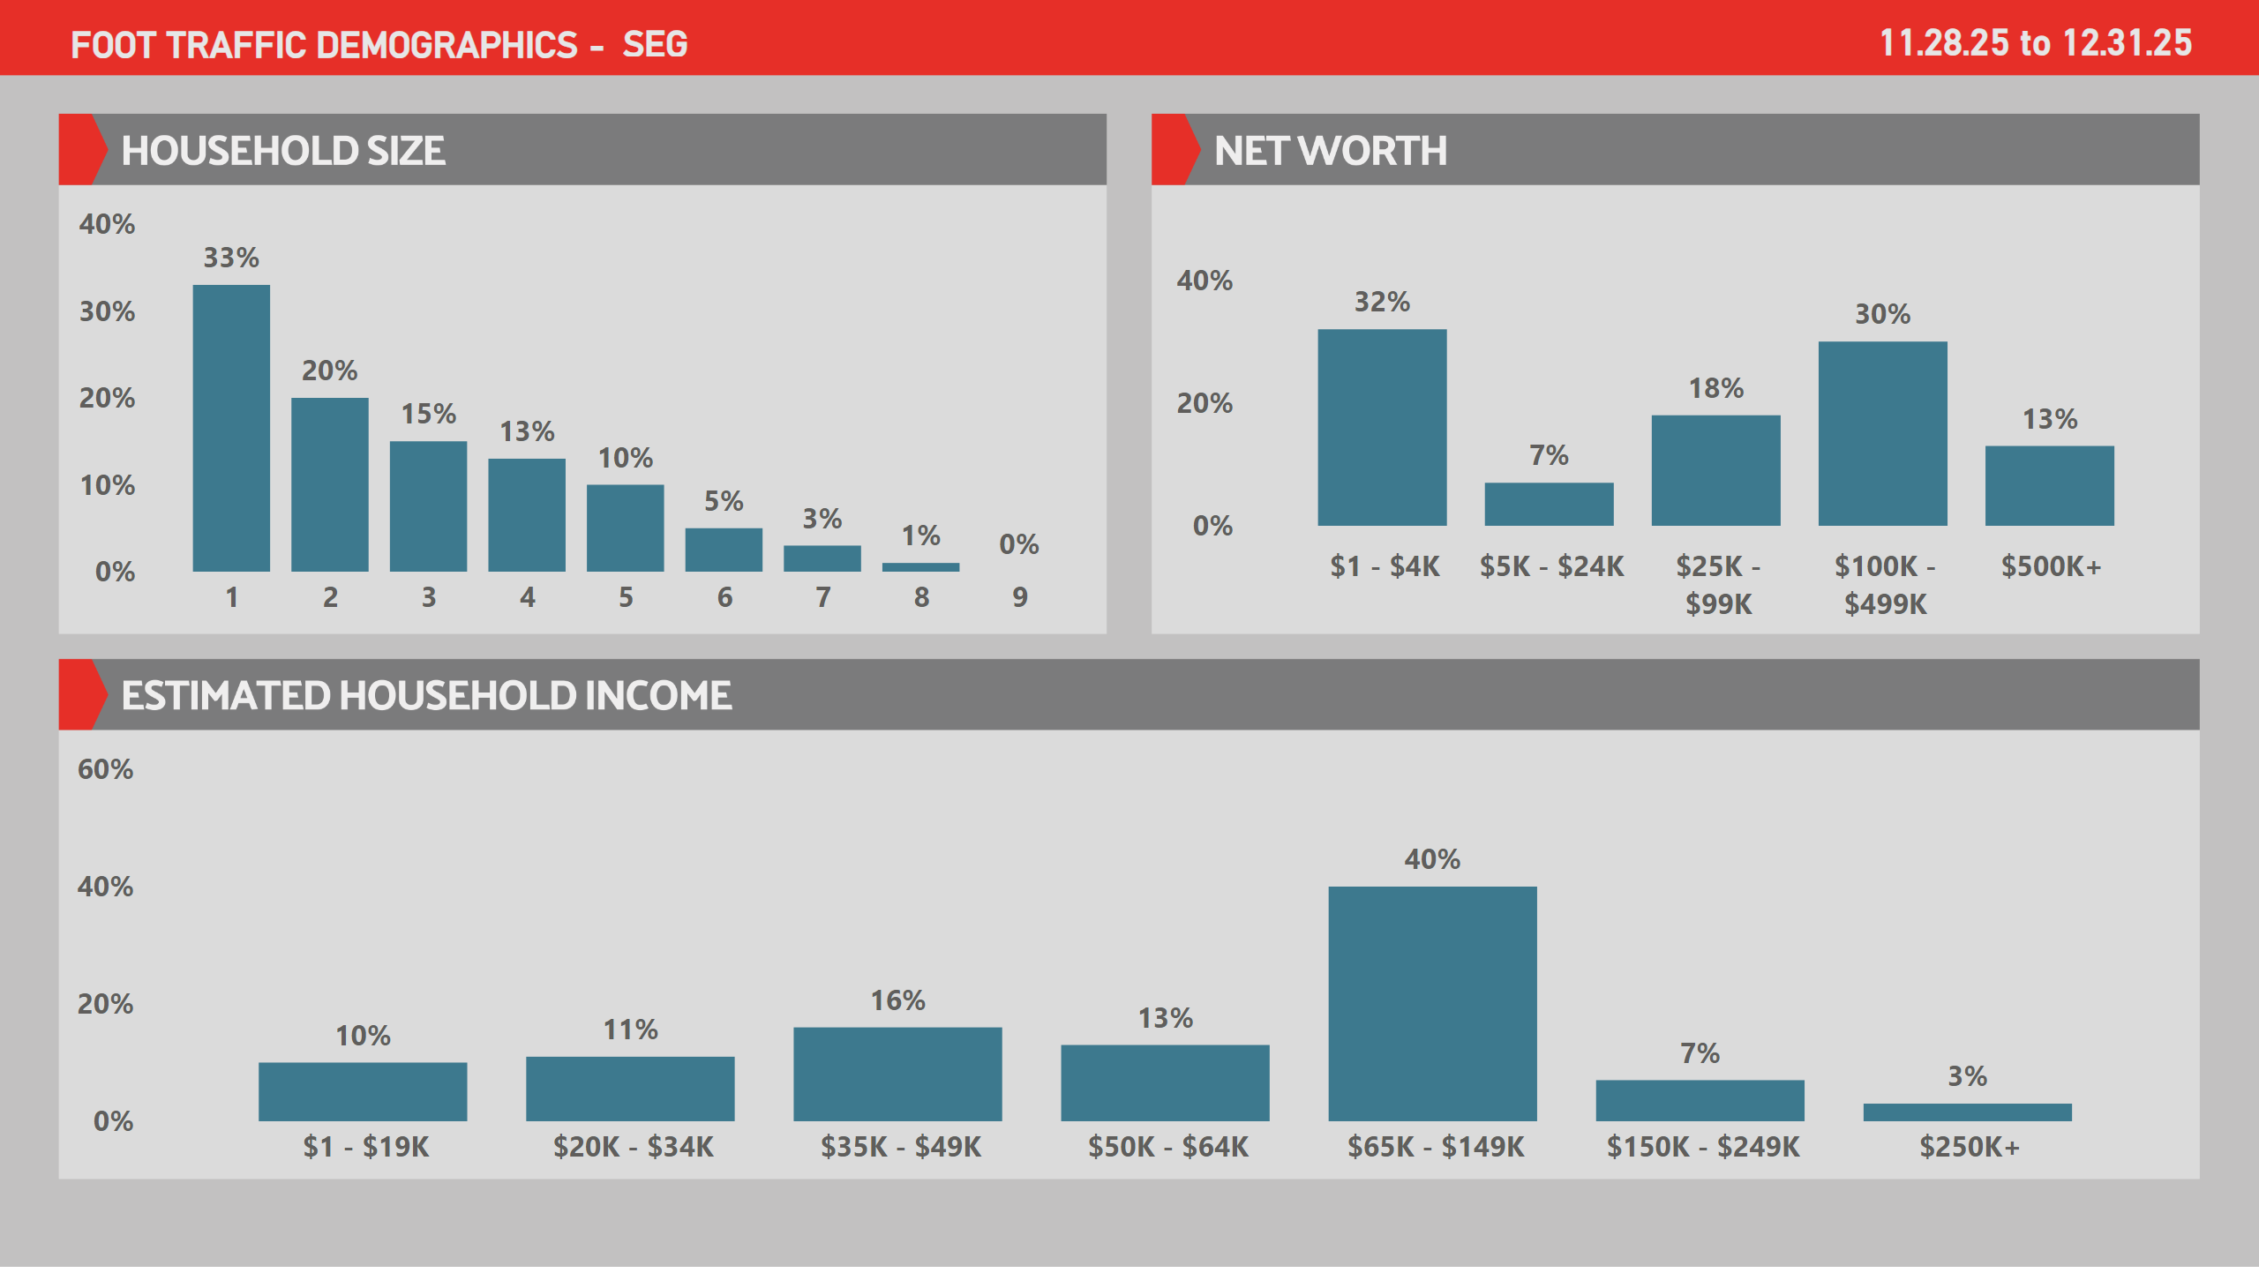
DSEG2
Notes:
Column Chart - Age
No alt text provided
Column Chart - Age
No alt text provided
cardVisual
No alt text provided
Ad. Card - Demo Period
No alt text provided
Ad. Card - Demo Period
No alt text provided
cardVisual
No alt text provided
Column Chart - Age
No alt text provided
Column Chart - Age
No alt text provided

Slide 14
Campaign Summary
Southeastern Grocers – Winn Dixie Print to Digital Campaign
Budget Allocation
50%, Proportional Based on Store Sales
50%, Proportional Based on Known Transactions
Green, Amber, Red impact
Green = -10%
Amber = Neutral
Red = +10%
Current Customer vs Conquest Customer budget ratio
Green = 50% Current Customers, 50% Conquest Customers
Amber = 60% Current Customers, 40% Conquest Customers
Red = 70% Current Customers, 30% Conquest Customers
Number of weeks: ???
From 12/31/2025 to ???
Participating stores: 20 stores
Red Stores: 5 Stores
Amber Stores: 12 Stores
Green Stores: 3 Stores
Media Spend: $$$$$ total budget
$18,349.46 per week

Slide 15
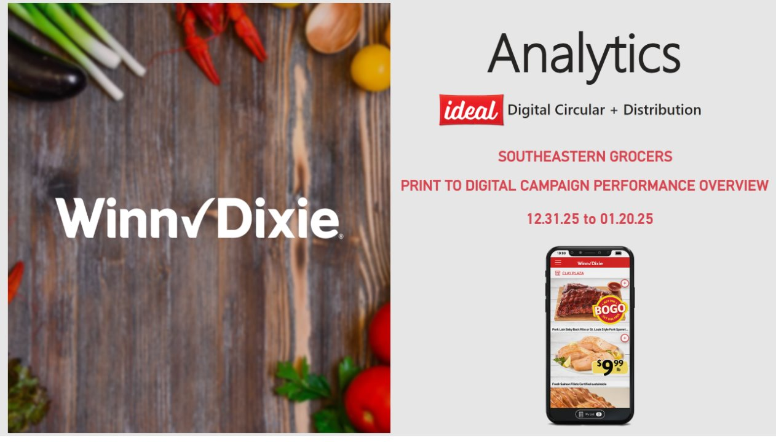
Cover
Notes:
shape
No alt text provided
Analytics Title
No alt text provided
Ad. Card Quarterly
No alt text provided
Ad. Card Quarterly
No alt text provided
Image - Ideal
No alt text provided
slicer
No alt text provided
shape
No alt text provided
slicer
No alt text provided
slicer
No alt text provided
Image - Ideal
No alt text provided
Ad. Card Digital Circular
No alt text provided
image
No alt text provided
image
No alt text provided
Ad. Card Quarterly
No alt text provided

Slide 16
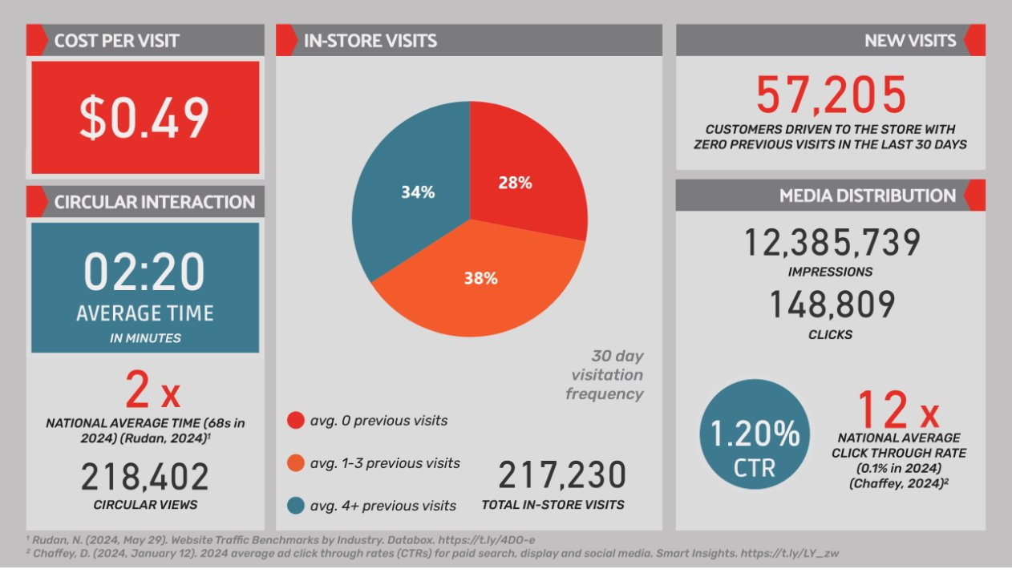
Analytics
Notes:
Ad. Card - CPV
No alt text provided
Pie Chart - VF
No alt text provided
Ad. Card - Visits
No alt text provided
Ad. Card - Time X
No alt text provided
Ad. Card - Views
No alt text provided
Ad. Card - Minutes
No alt text provided
Ad. Card - Clicks
No alt text provided
Ad. Card - Impressions
No alt text provided
Ad. Card - CTR
No alt text provided
Ad. Card - CTR X
No alt text provided
cardVisual
No alt text provided
cardVisual
No alt text provided
image
No alt text provided
slicer
No alt text provided
slicer
No alt text provided
slicer
No alt text provided
image
No alt text provided
Ad. Card - New Visits
No alt text provided

Slide 17
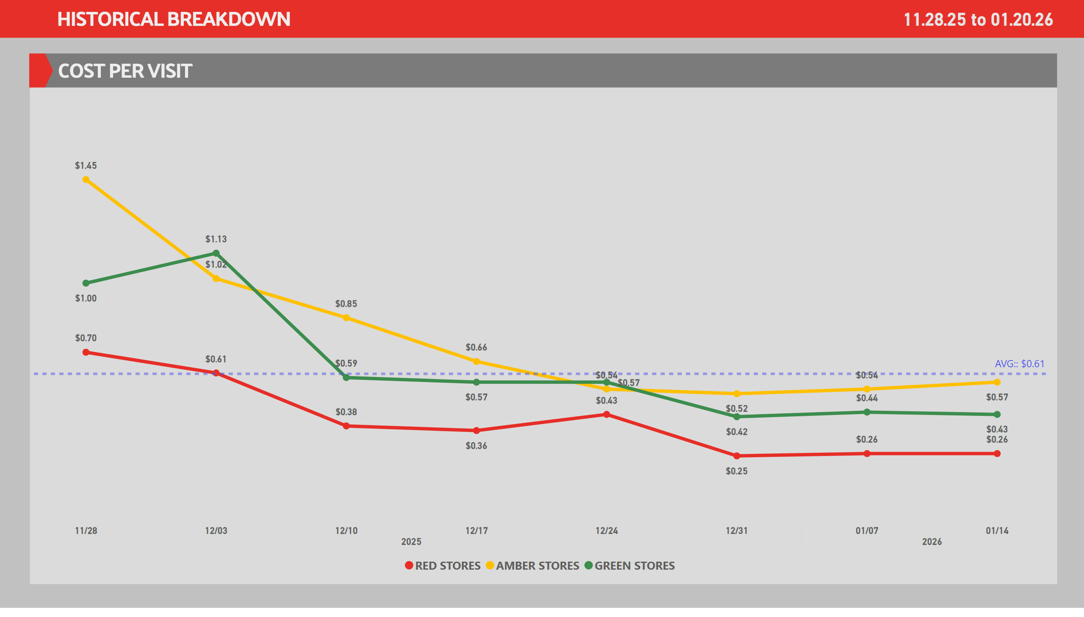
CPV's
Notes:
shape
No alt text provided
lineChart
No alt text provided
lineChart
No alt text provided
Ad. Card - Demo Period
No alt text provided
Line Chart - CPV
No alt text provided
slicer
No alt text provided
slicer
No alt text provided

Slide 18
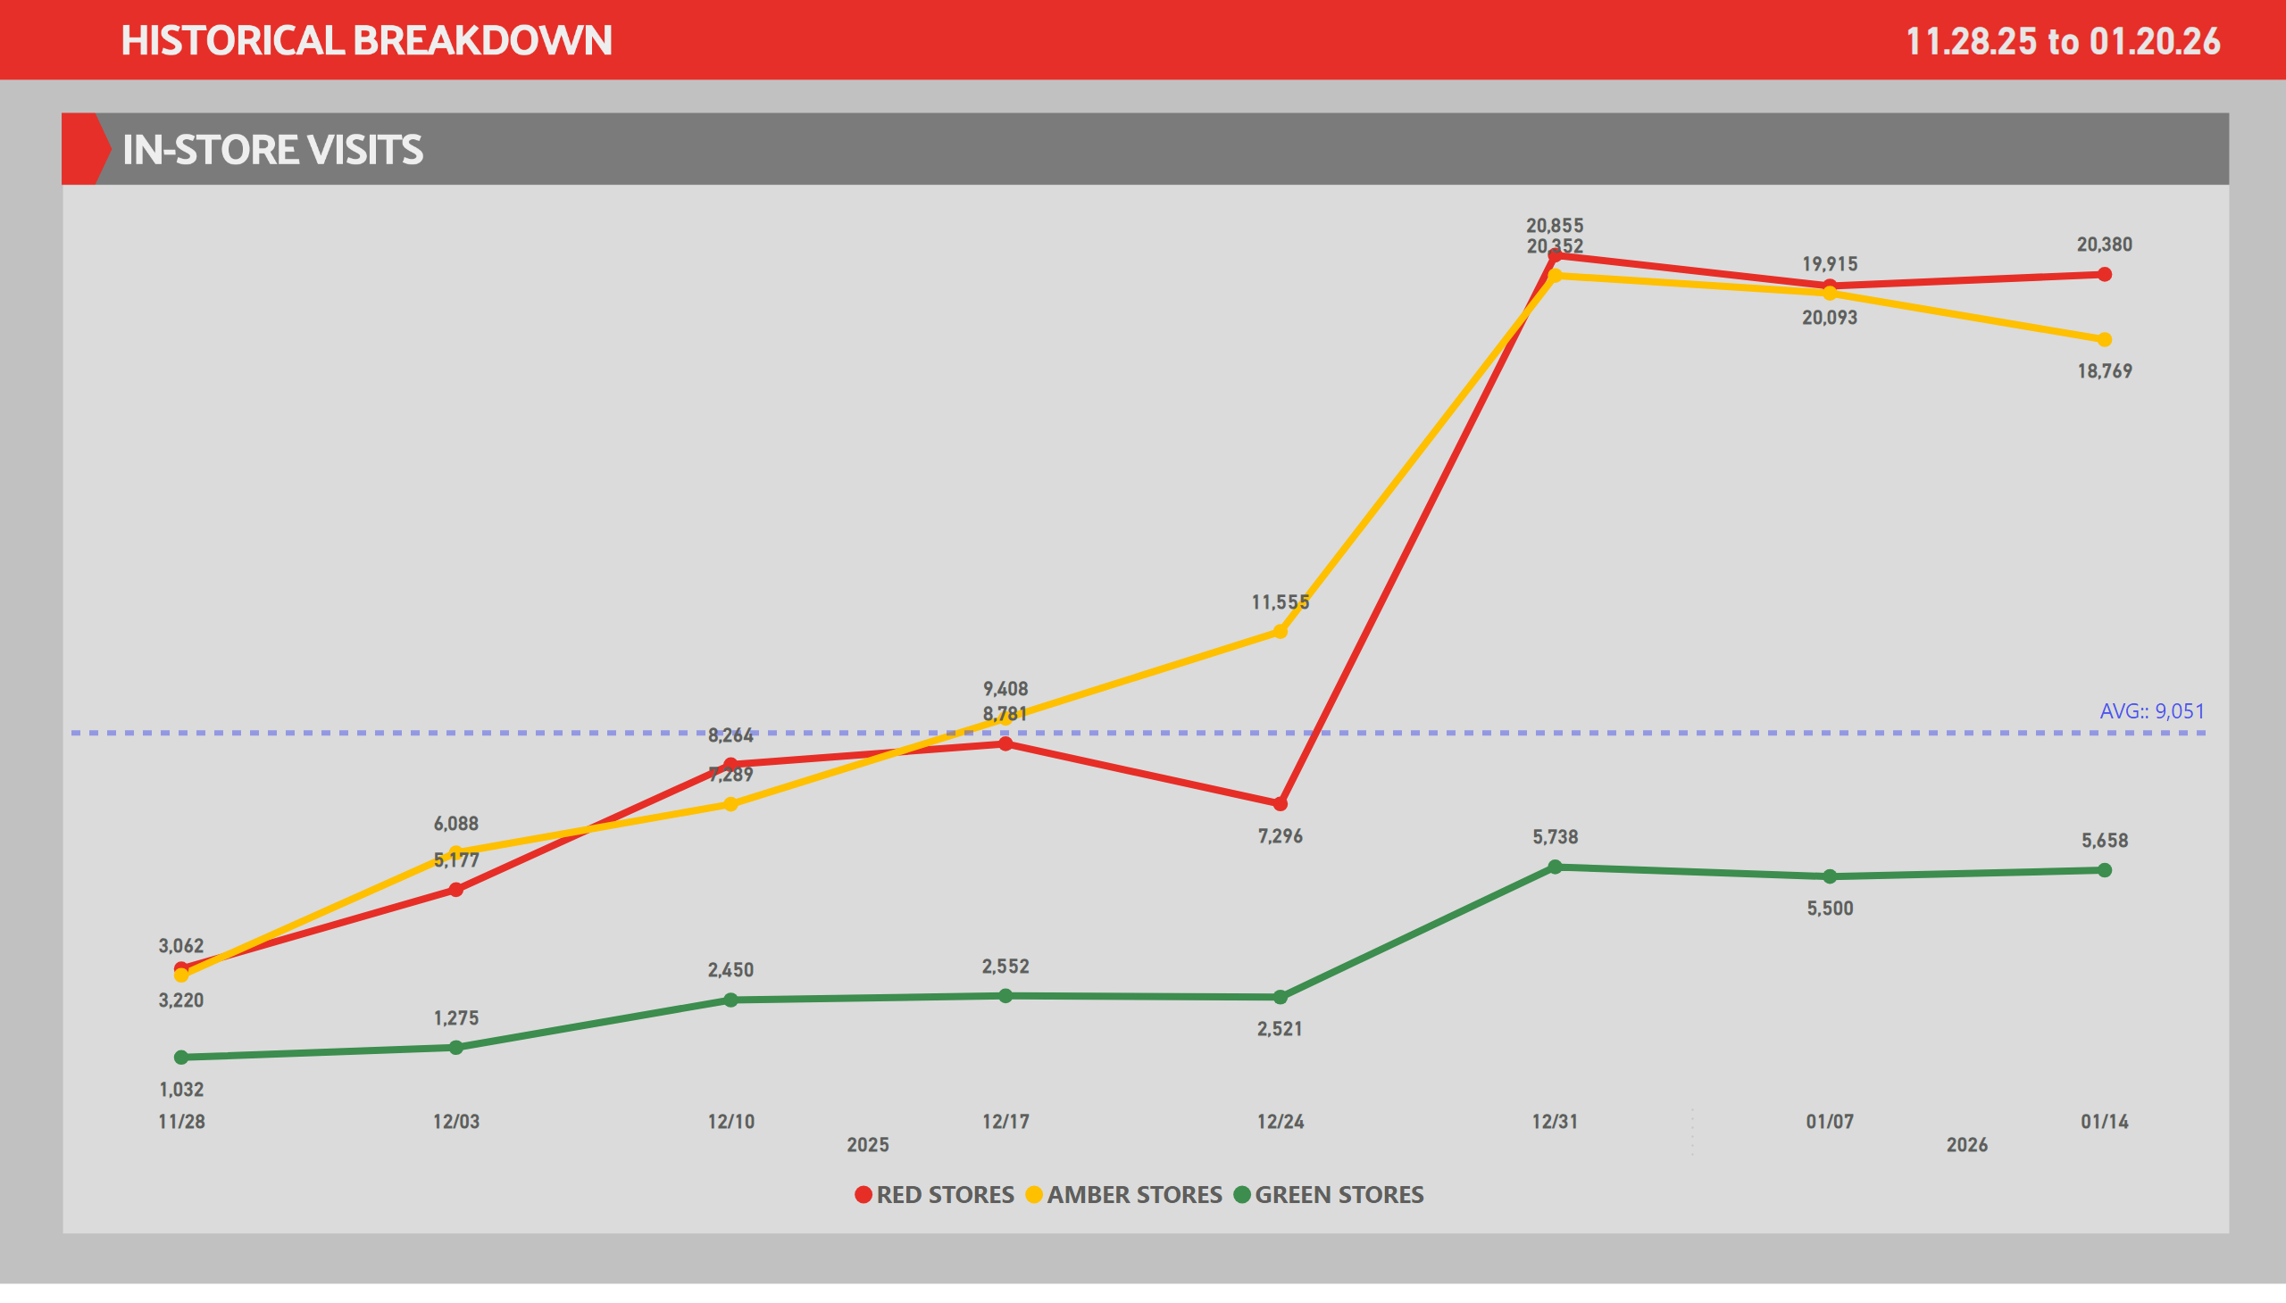

Slide 19
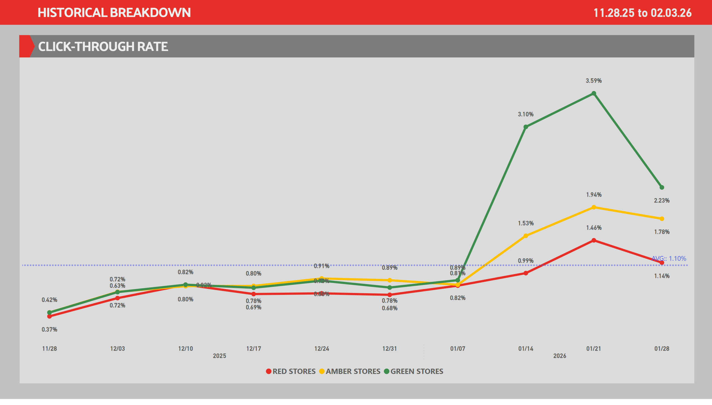
CTR
Notes:
lineChart
No alt text provided
lineChart
No alt text provided
Ad. Card - Demo Period
No alt text provided
Line Chart - CTR
No alt text provided
slicer
No alt text provided
slicer
No alt text provided

Slide 20
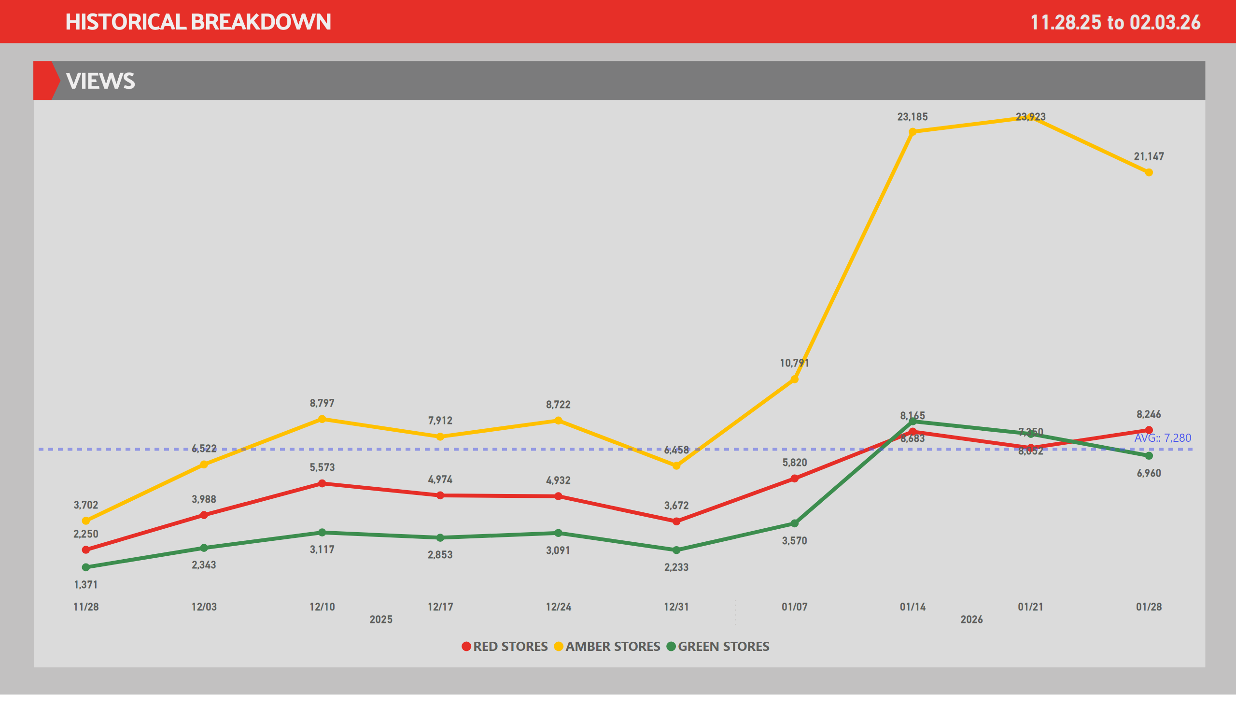
Views
Notes:
lineChart
No alt text provided
lineChart
No alt text provided
Ad. Card - Demo Period
No alt text provided
Line Chart - Views
No alt text provided
slicer
No alt text provided
slicer
No alt text provided

Slide 21
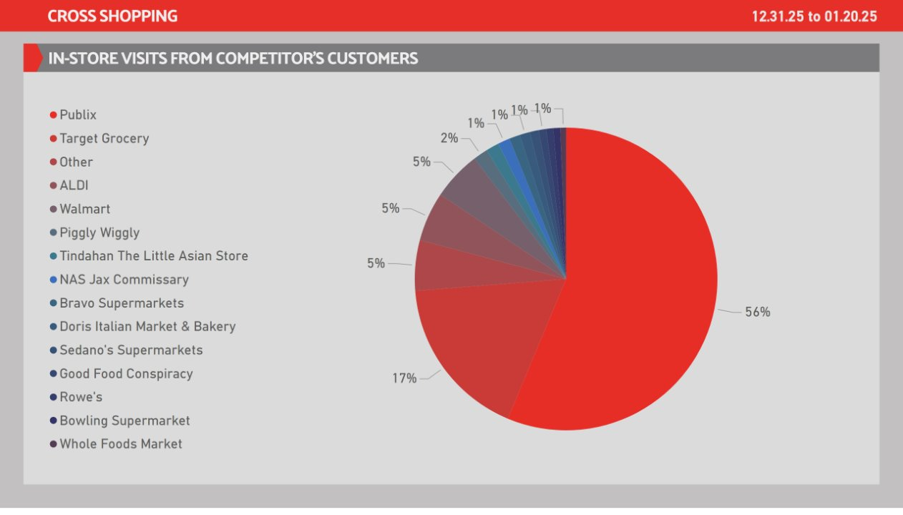
Analytics
Notes:
Ad. Card - CPV
No alt text provided
Pie Chart - VF
No alt text provided
Ad. Card - Visits
No alt text provided
Ad. Card - Time X
No alt text provided
Ad. Card - Views
No alt text provided
Ad. Card - Minutes
No alt text provided
Ad. Card - Clicks
No alt text provided
Ad. Card - Impressions
No alt text provided
Ad. Card - CTR
No alt text provided
Ad. Card - CTR X
No alt text provided
cardVisual
No alt text provided
cardVisual
No alt text provided
image
No alt text provided
slicer
No alt text provided
slicer
No alt text provided
slicer
No alt text provided
image
No alt text provided
Ad. Card - New Visits
No alt text provided

Slide 22
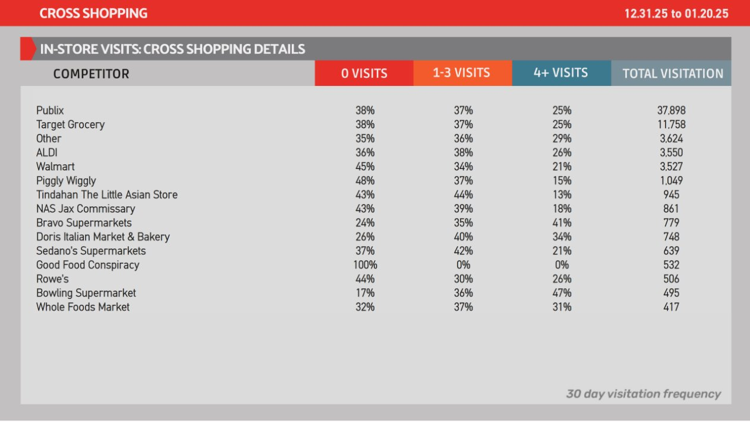
Analytics
Notes:
Ad. Card - CPV
No alt text provided
Pie Chart - VF
No alt text provided
Ad. Card - Visits
No alt text provided
Ad. Card - Time X
No alt text provided
Ad. Card - Views
No alt text provided
Ad. Card - Minutes
No alt text provided
Ad. Card - Clicks
No alt text provided
Ad. Card - Impressions
No alt text provided
Ad. Card - CTR
No alt text provided
Ad. Card - CTR X
No alt text provided
cardVisual
No alt text provided
cardVisual
No alt text provided
image
No alt text provided
slicer
No alt text provided
slicer
No alt text provided
slicer
No alt text provided
image
No alt text provided
Ad. Card - New Visits
No alt text provided

Slide 23
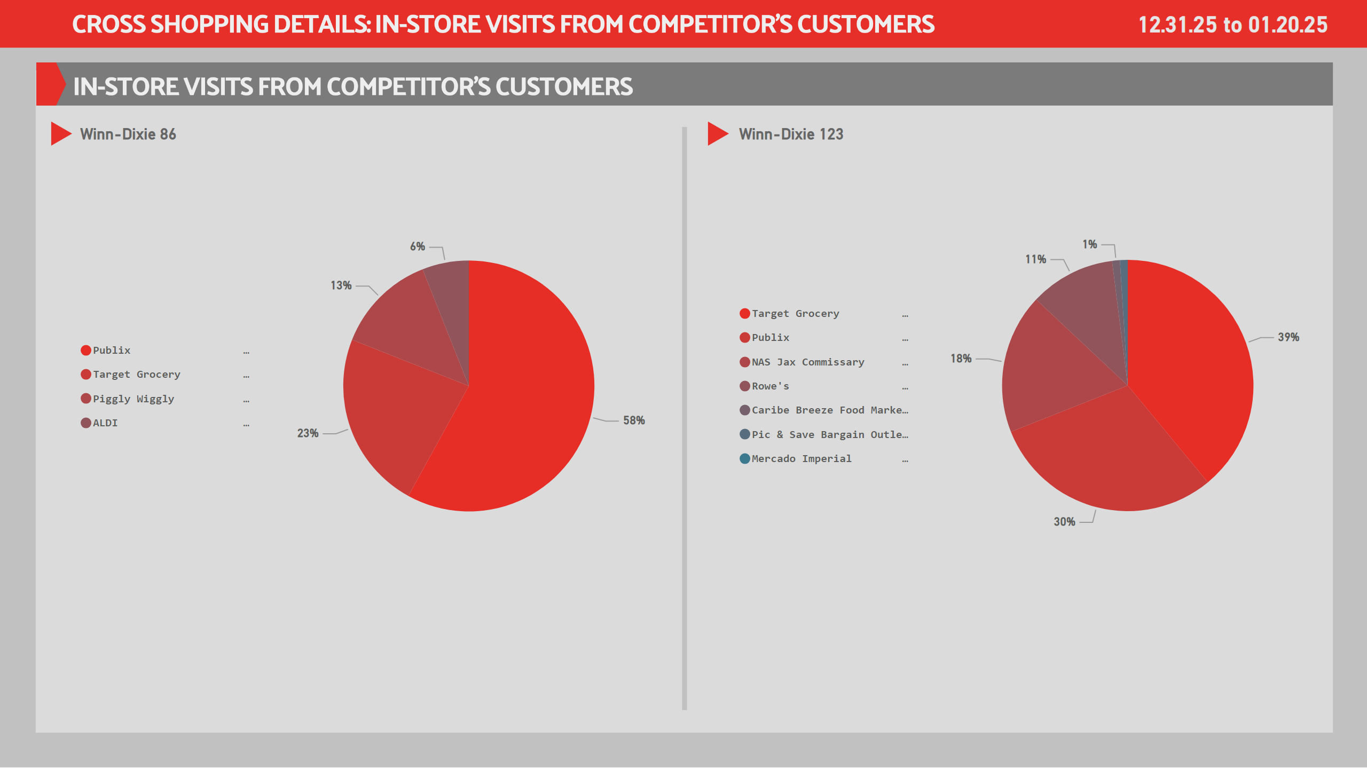
CD - 1
Notes:
Winn-Dixie 123
No alt text provided
Ad. Card - Demo Period
No alt text provided
slicer
No alt text provided
slicer
No alt text provided
tableEx
No alt text provided
slicer
No alt text provided
Winn-Dixie 86
No alt text provided

Slide 24
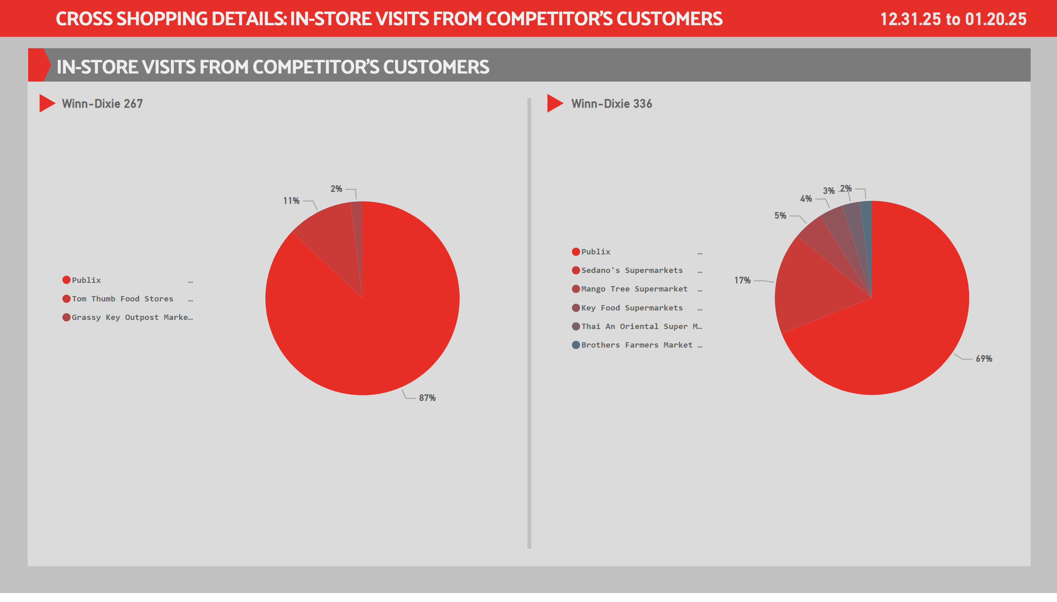
CD - 2
Notes:
Winn-Dixie 267
No alt text provided
Winn-Dixie 336
No alt text provided
Ad. Card - Demo Period
No alt text provided
slicer
No alt text provided
slicer
No alt text provided
tableEx
No alt text provided
slicer
No alt text provided

Slide 25
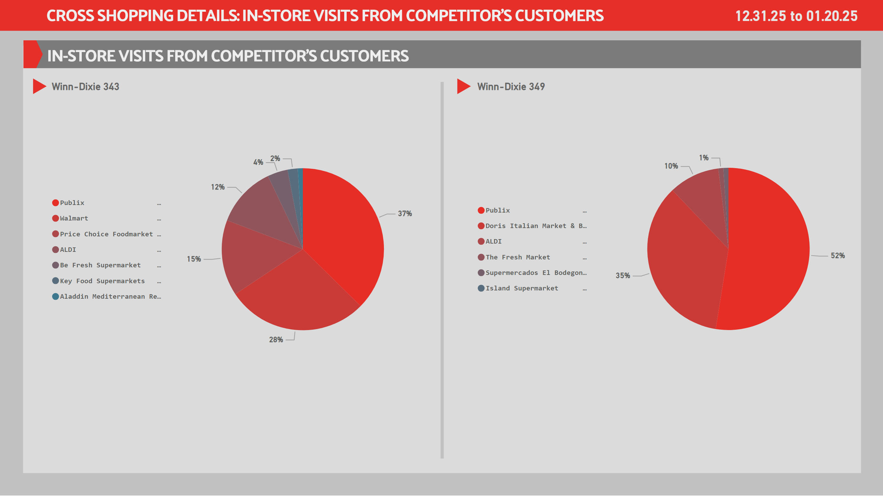
CD - 3
Notes:
Winn-Dixie 343
No alt text provided
Winn-Dixie 349
No alt text provided
Ad. Card - Demo Period
No alt text provided
slicer
No alt text provided
slicer
No alt text provided
tableEx
No alt text provided
slicer
No alt text provided

Slide 26
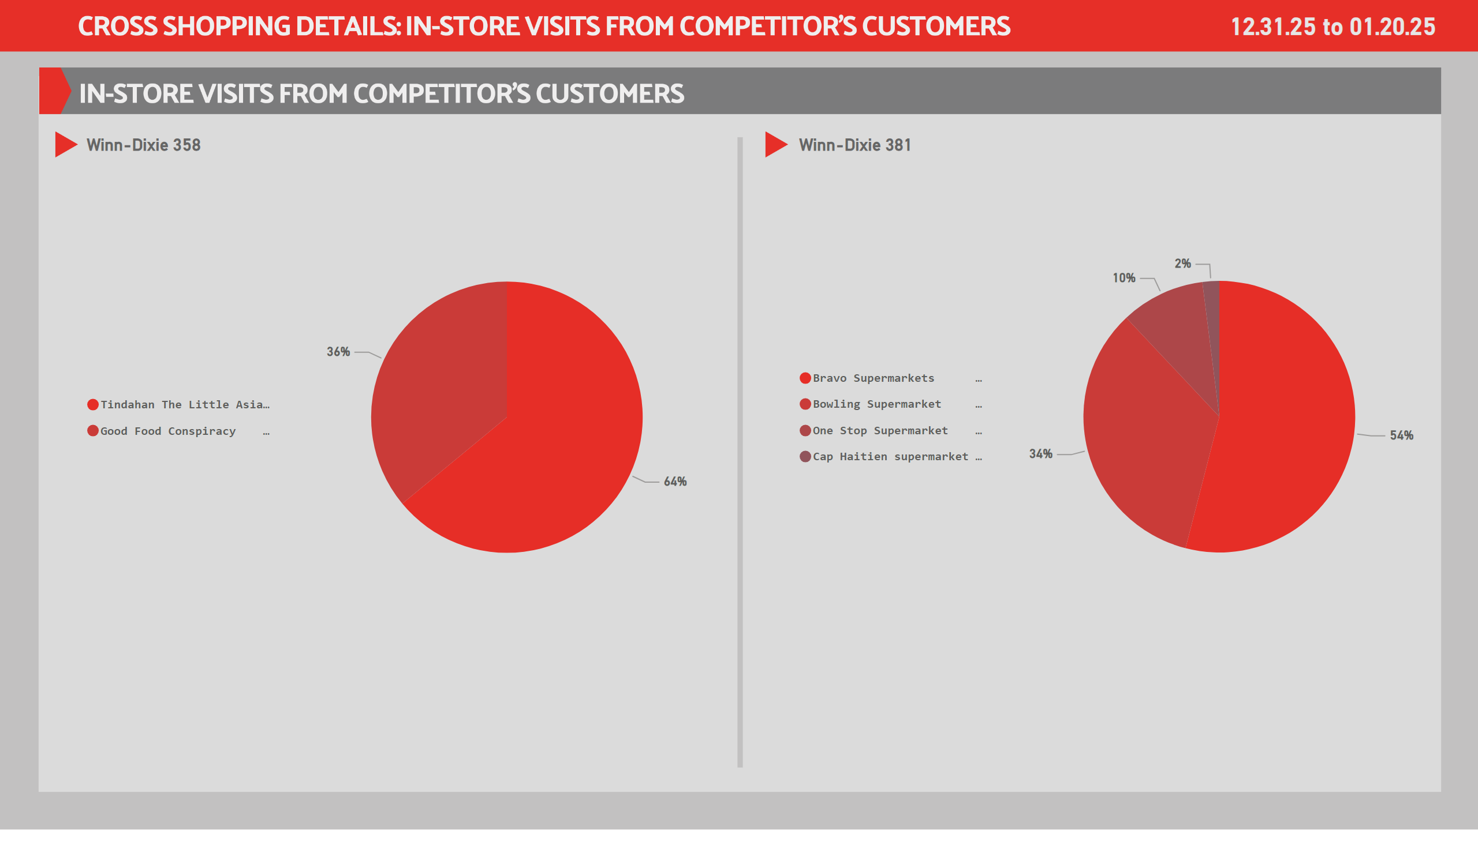
CD - 4
Notes:
Winn-Dixie 358
No alt text provided
Winn-Dixie 381
No alt text provided
Ad. Card - Demo Period
No alt text provided
slicer
No alt text provided
slicer
No alt text provided
tableEx
No alt text provided
slicer
No alt text provided

Slide 27

CD - 5
Notes:
Winn-Dixie 436
No alt text provided
Winn-Dixie 481
No alt text provided
Ad. Card - Demo Period
No alt text provided
slicer
No alt text provided
slicer
No alt text provided
tableEx
No alt text provided
slicer
No alt text provided

Slide 28
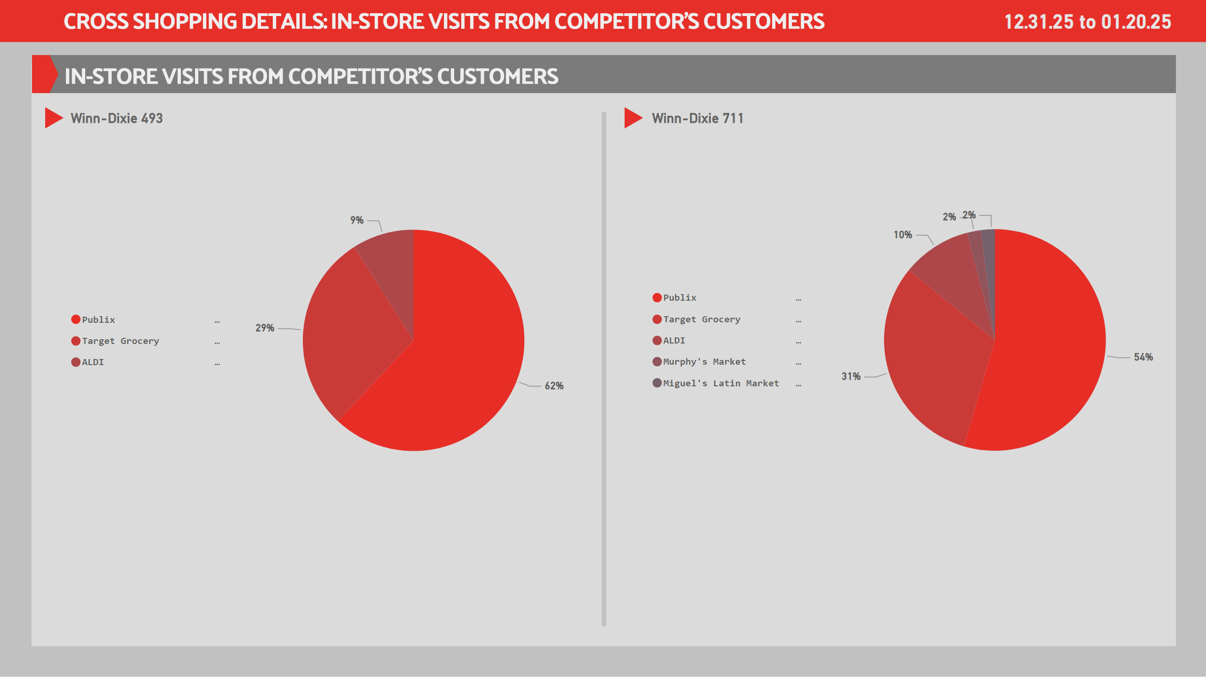
CD - 6
Notes:
Winn-Dixie 493
No alt text provided
Winn-Dixie 711
No alt text provided
Ad. Card - Demo Period
No alt text provided
slicer
No alt text provided
slicer
No alt text provided
tableEx
No alt text provided
slicer
No alt text provided

Slide 29

CD - 7
Notes:
Winn-Dixie 726
No alt text provided
Winn-Dixie 2269
No alt text provided
Ad. Card - Demo Period
No alt text provided
slicer
No alt text provided
slicer
No alt text provided
tableEx
No alt text provided
slicer
No alt text provided

Slide 30
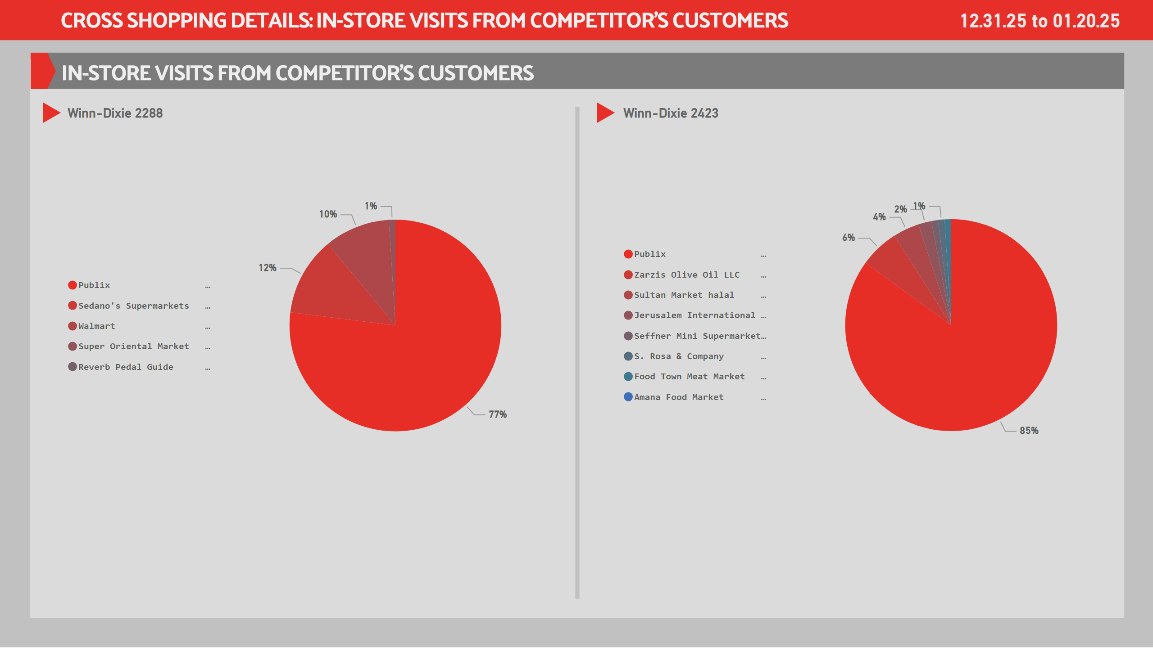
CD - 8
Notes:
Winn-Dixie 2288
No alt text provided
Winn-Dixie 2423
No alt text provided
Ad. Card - Demo Period
No alt text provided
slicer
No alt text provided
slicer
No alt text provided
tableEx
No alt text provided
slicer
No alt text provided

Slide 31
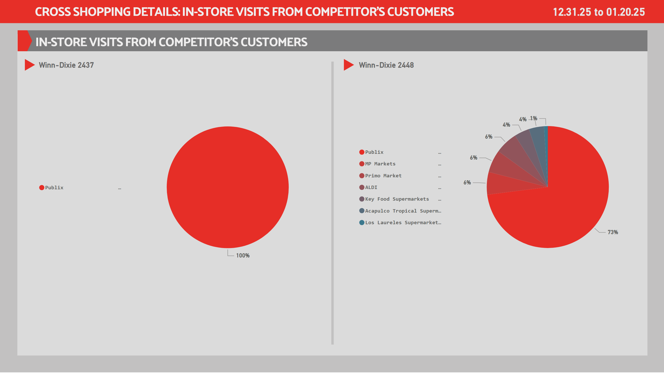
CD - 9
Notes:
Winn-Dixie 2437
No alt text provided
Winn-Dixie 2448
No alt text provided
Ad. Card - Demo Period
No alt text provided
slicer
No alt text provided
slicer
No alt text provided
tableEx
No alt text provided
slicer
No alt text provided

Slide 32
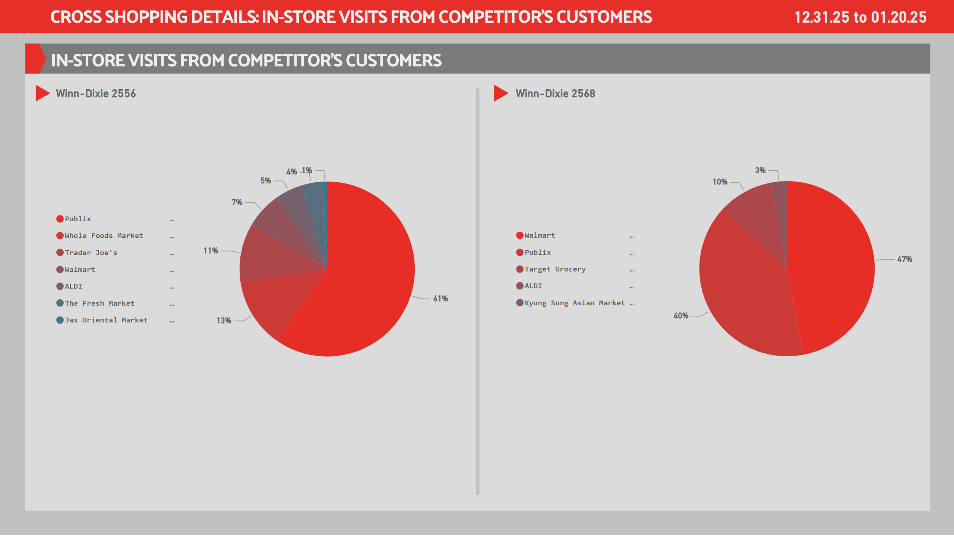
CD - 10
Notes:
Winn-Dixie 2556
No alt text provided
Winn-Dixie 2568
No alt text provided
Ad. Card - Demo Period
No alt text provided
slicer
No alt text provided
slicer
No alt text provided
tableEx
No alt text provided
slicer
No alt text provided

Slide 33


Executive Summary
Southeastern Grocers – Winn-Dixie Print to Digital Campaign
What changed across the 20 consistent Winn-Dixie stores in the competitive set
Participating stores
20
Stores outperforming competitors
15/20
WD share change (12/10 flight → 1/7 flight)
8%
Consistent since program start
Within each WD-group competitive set
Frequency charts (0, 1–3, 4+ visit buckets) show how the loyalty mix shifts week-to-week independent of total volume.
Competitive benchmarking compares Winn-Dixie to nearby competitor visits within each WD group (market context).
Pre vs. post media-exposure visit lift (flight vs. lookback) is still being processed and is not included in this cut.

Slide 34

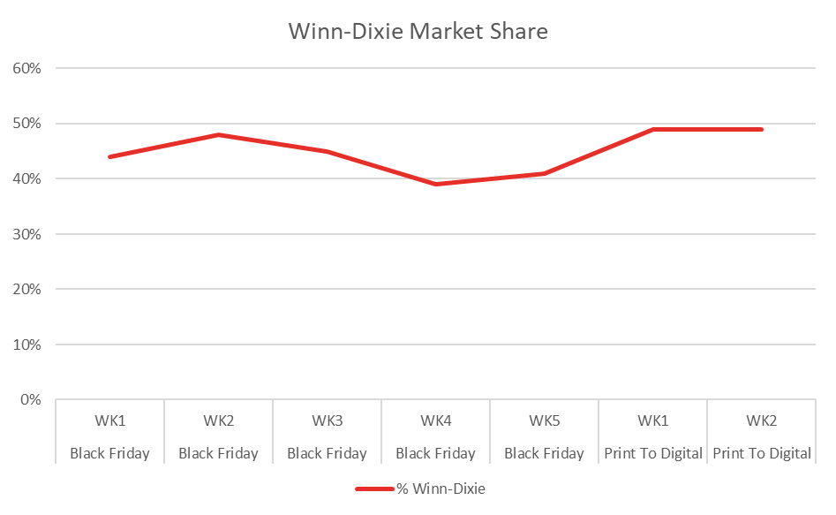
Southeastern Grocers – Winn-Dixie Print to Digital Campaign
Winn-Dixie share trend (competitive set)
Winn-Dixie’s share grew from 40.5% to 48.5% across the panel. That is an 8-point gain inside
competitive trade areas.

Slide 35
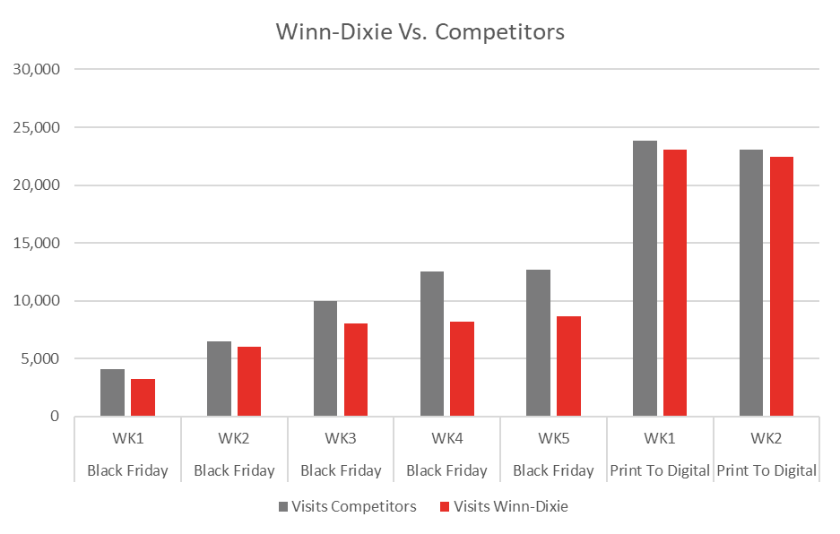
Southeastern Grocers – Winn-Dixie Print to Digital Campaign
Weekly visits: Winn-Dixie vs competitors
Volume naturally fluctuates due to holidays, but when we pair this with frequency data, we see something more important: loyalty is increasing even when volume normalizes.

Slide 36
Southeastern Grocers – Winn-Dixie Print to Digital Campaign​
​
Growth Stores
Winn-Dixie Store | BFWk3 | P2DWk2 | Market Shift | Primary Threat
Winn-Dixie 726 | 12.91% | 82.14% | +69.23% | Publix Super Market at Calusa Cay
Winn-Dixie 381 | 54.28% | 71.15% | +16.87% | Cap Haitien Supermarket at 216 SW 6th St, Belle Glade, FL 33430
Winn-Dixie 336 | 38.81% | 54.37% | +15.56% | Publix Super Market at Oakbridge-3102 Griffin Road
Winn-Dixie 2437 | 52.17% | 64.14% | +11.98% | Publix Super Market at Pearl Britain Plaza
Winn-Dixie 2288 | 45.31% | 56.65% | +11.34% | Publix Super Market at Conway Crossing
Winn-Dixie 711 | 38.35% | 48.54% | +10.20% | Publix Super Market at Hernando West
Winn-Dixie 493 | 42.68% | 50.37% | +7.69% | Publix Super Market at Shops At Perdido Key
Winn-Dixie 358 | 77.78% | 85.00% | +7.22% | Tindahan – The Little Asian Store at 33 Ships Way, Big Pine Key, FL 33043
Winn-Dixie 2568 | 27.66% | 34.68% | +7.01% | Aldi at 1539 W New Haven Ave, Melbourne, Fl 32904
Winn-Dixie 2448 | 39.07% | 43.86% | +4.79% | Publix Super Market at Westgate Shopping Center
Winn-Dixie 436 | 37.96% | 42.40% | +4.44% | Aldi at 3157 West 23Rd Street, Lynn Haven, Fl 32444
Winn-Dixie 123 | 45.87% | 49.08% | +3.21% | Caribe Breeze Food Market at 7244 Blanding Blvd, Jack
Winn-Dixie 2556 | 17.96% | 20.73% | +2.77% | Publix Super Market at Mandarin Oaks Shopping Center

Slide 37
Southeastern Grocers – Winn-Dixie Print to Digital Campaign​
​
Neutral Stores
Winn-Dixie Store | BFWk3 | P2DWk2 | Market Shift | Primary Threat
Winn-Dixie 2423 | 39.82% | 41.67% | +1.85% | Publix Super Market at Terrace Ridge Plaza
Winn-Dixie 2269 | 37.46% | 38.75% | +1.29% | Walmart Neighborhood Market at 433 Avalon Park South
Winn-Dixie 349 | 57.91% | 56.79% | -1.12% | The Fresh Market at 4633 N University Dr, Coral Springs, FL 33067
Winn-Dixie 481 | 47.49% | 46.37% | -1.12% | Aldi at 5500 E 7Th St, Panama City, Fl 32404
Winn-Dixie 343 | 54.60% | 53.43% | -1.17% | Walmart Neighborhood Market at 3791 NW 167th St, Miami Gardens, FL 33055

Slide 38
Southeastern Grocers – Winn-Dixie Print to Digital Campaign
Opportunity Stores
Winn-Dixie Store | BFWk3 | P2DWk2 | Market Shift | Primary Threat
Winn-Dixie 267 | 55.31% | 47.47% | -7.84% | Publix Super Market At Marathon
Winn-Dixie 86 | 34.24% | 22.46% | -11.78% | Publix Super Market at Lake Ella Plaza

Slide 39
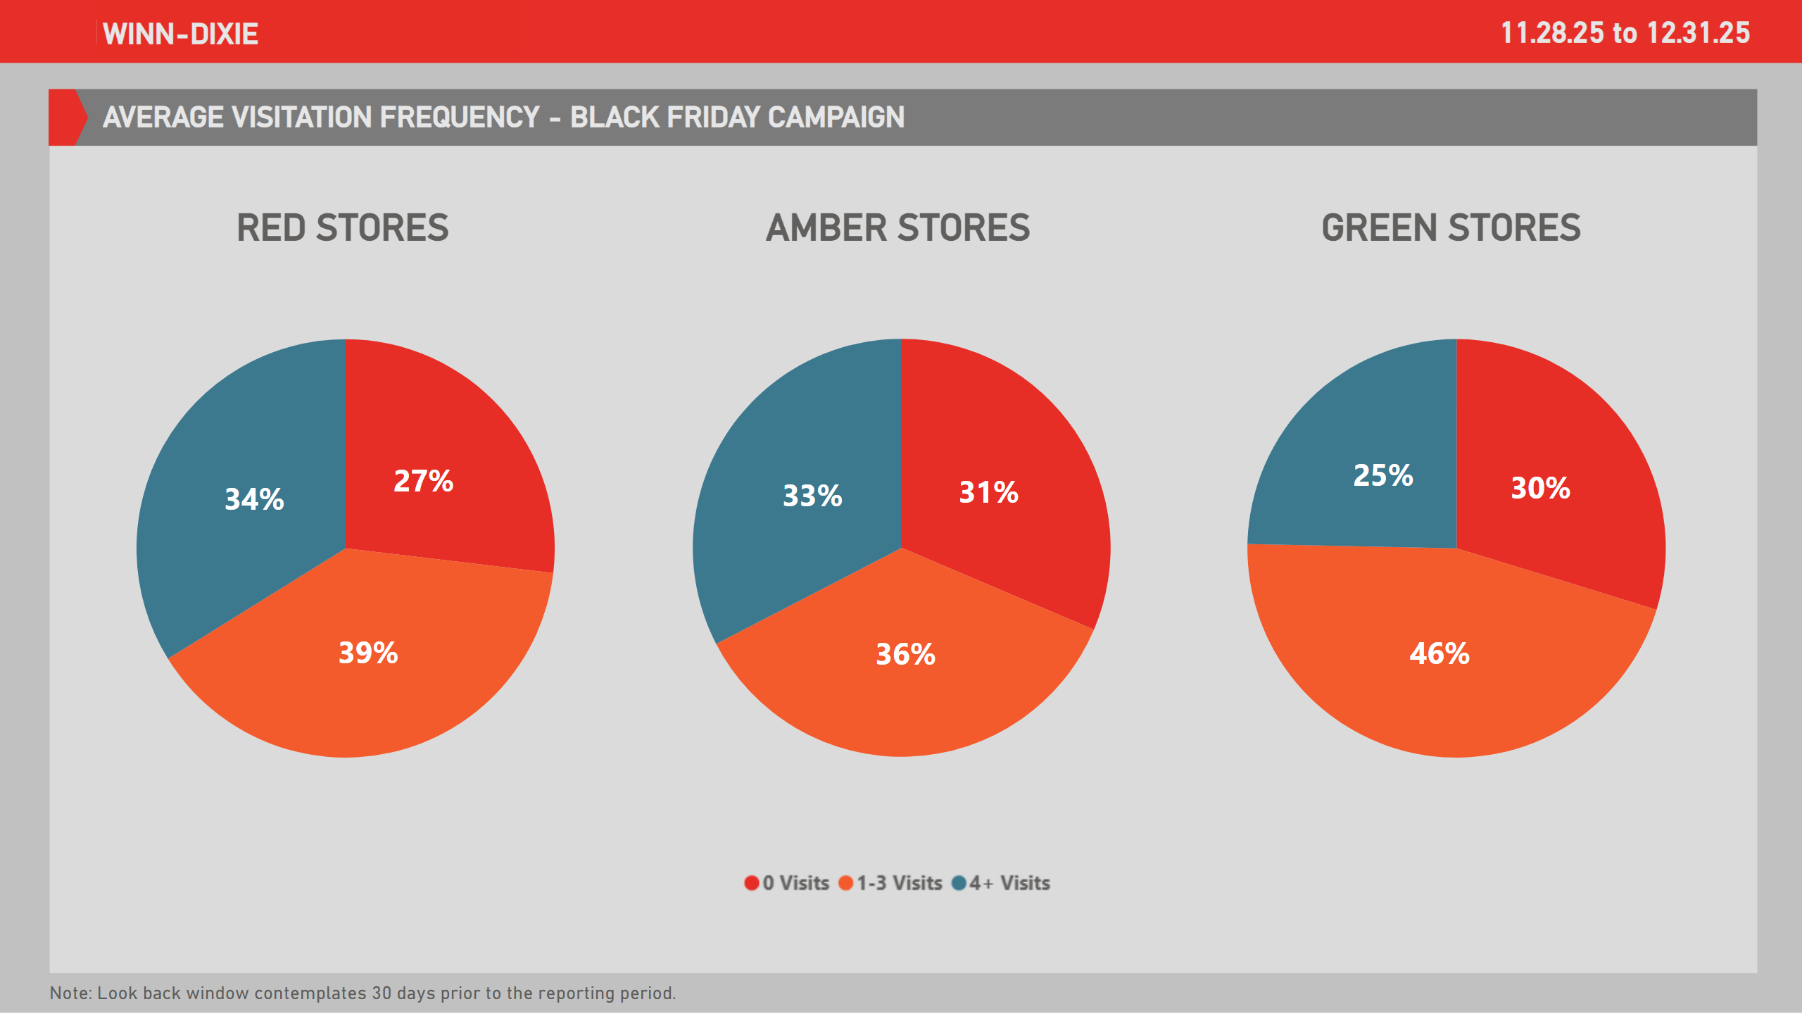
VFs - New 1
Notes:
lineChart
No alt text provided
lineChart
No alt text provided
Ad. Card - Demo Period
No alt text provided
slicer
No alt text provided
slicer
No alt text provided
shape
No alt text provided
shape
No alt text provided
Ad. Card - Demo Period
No alt text provided
Ad. Card - Demo Period
No alt text provided
image
No alt text provided
RED STORES
No alt text provided
GREEN STORES
No alt text provided
AMBER STORES
No alt text provided
Ad. Card - Demo Period
No alt text provided
Ad. Card - Demo Period
No alt text provided
Ad. Card - Demo Period
No alt text provided
Ad. Card - Demo Period
No alt text provided

Slide 40
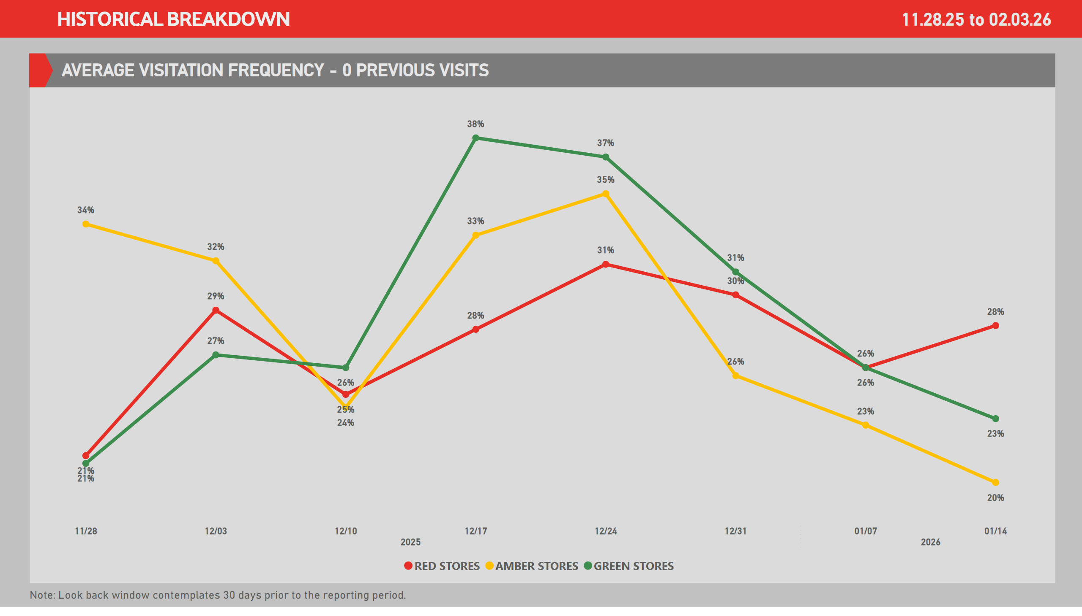
VF 0
Notes:
lineChart
No alt text provided
lineChart
No alt text provided
Ad. Card - Demo Period
No alt text provided
slicer
No alt text provided
slicer
No alt text provided
Ad. Card - Demo Period
No alt text provided
Line Chart - Visits
No alt text provided
Ad. Card - Demo Period
No alt text provided

Slide 41
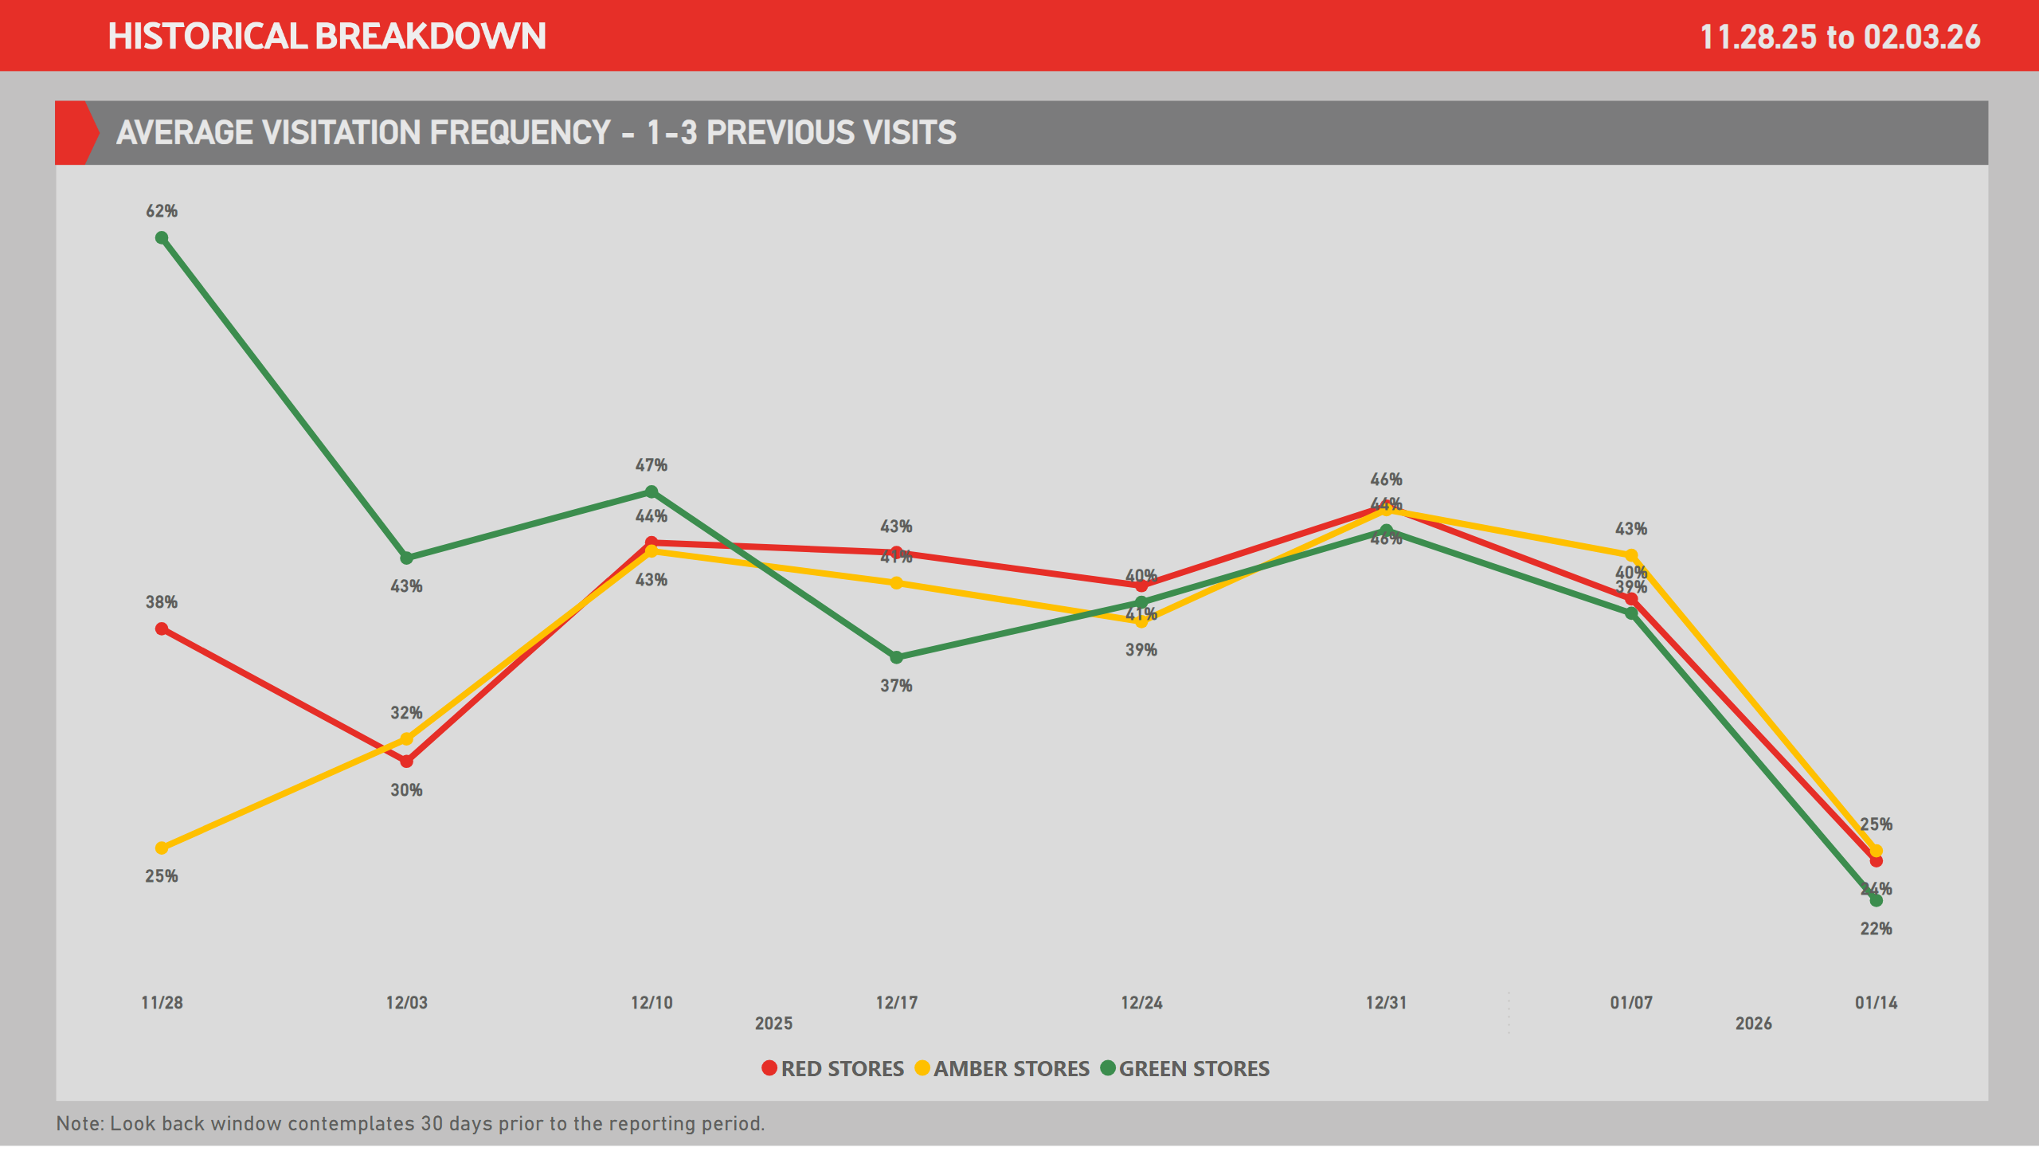
VF 1-3
Notes:
lineChart
No alt text provided
lineChart
No alt text provided
Ad. Card - Demo Period
No alt text provided
slicer
No alt text provided
slicer
No alt text provided
Ad. Card - Demo Period
No alt text provided
Line Chart - Visits
No alt text provided
Ad. Card - Demo Period
No alt text provided

Slide 42
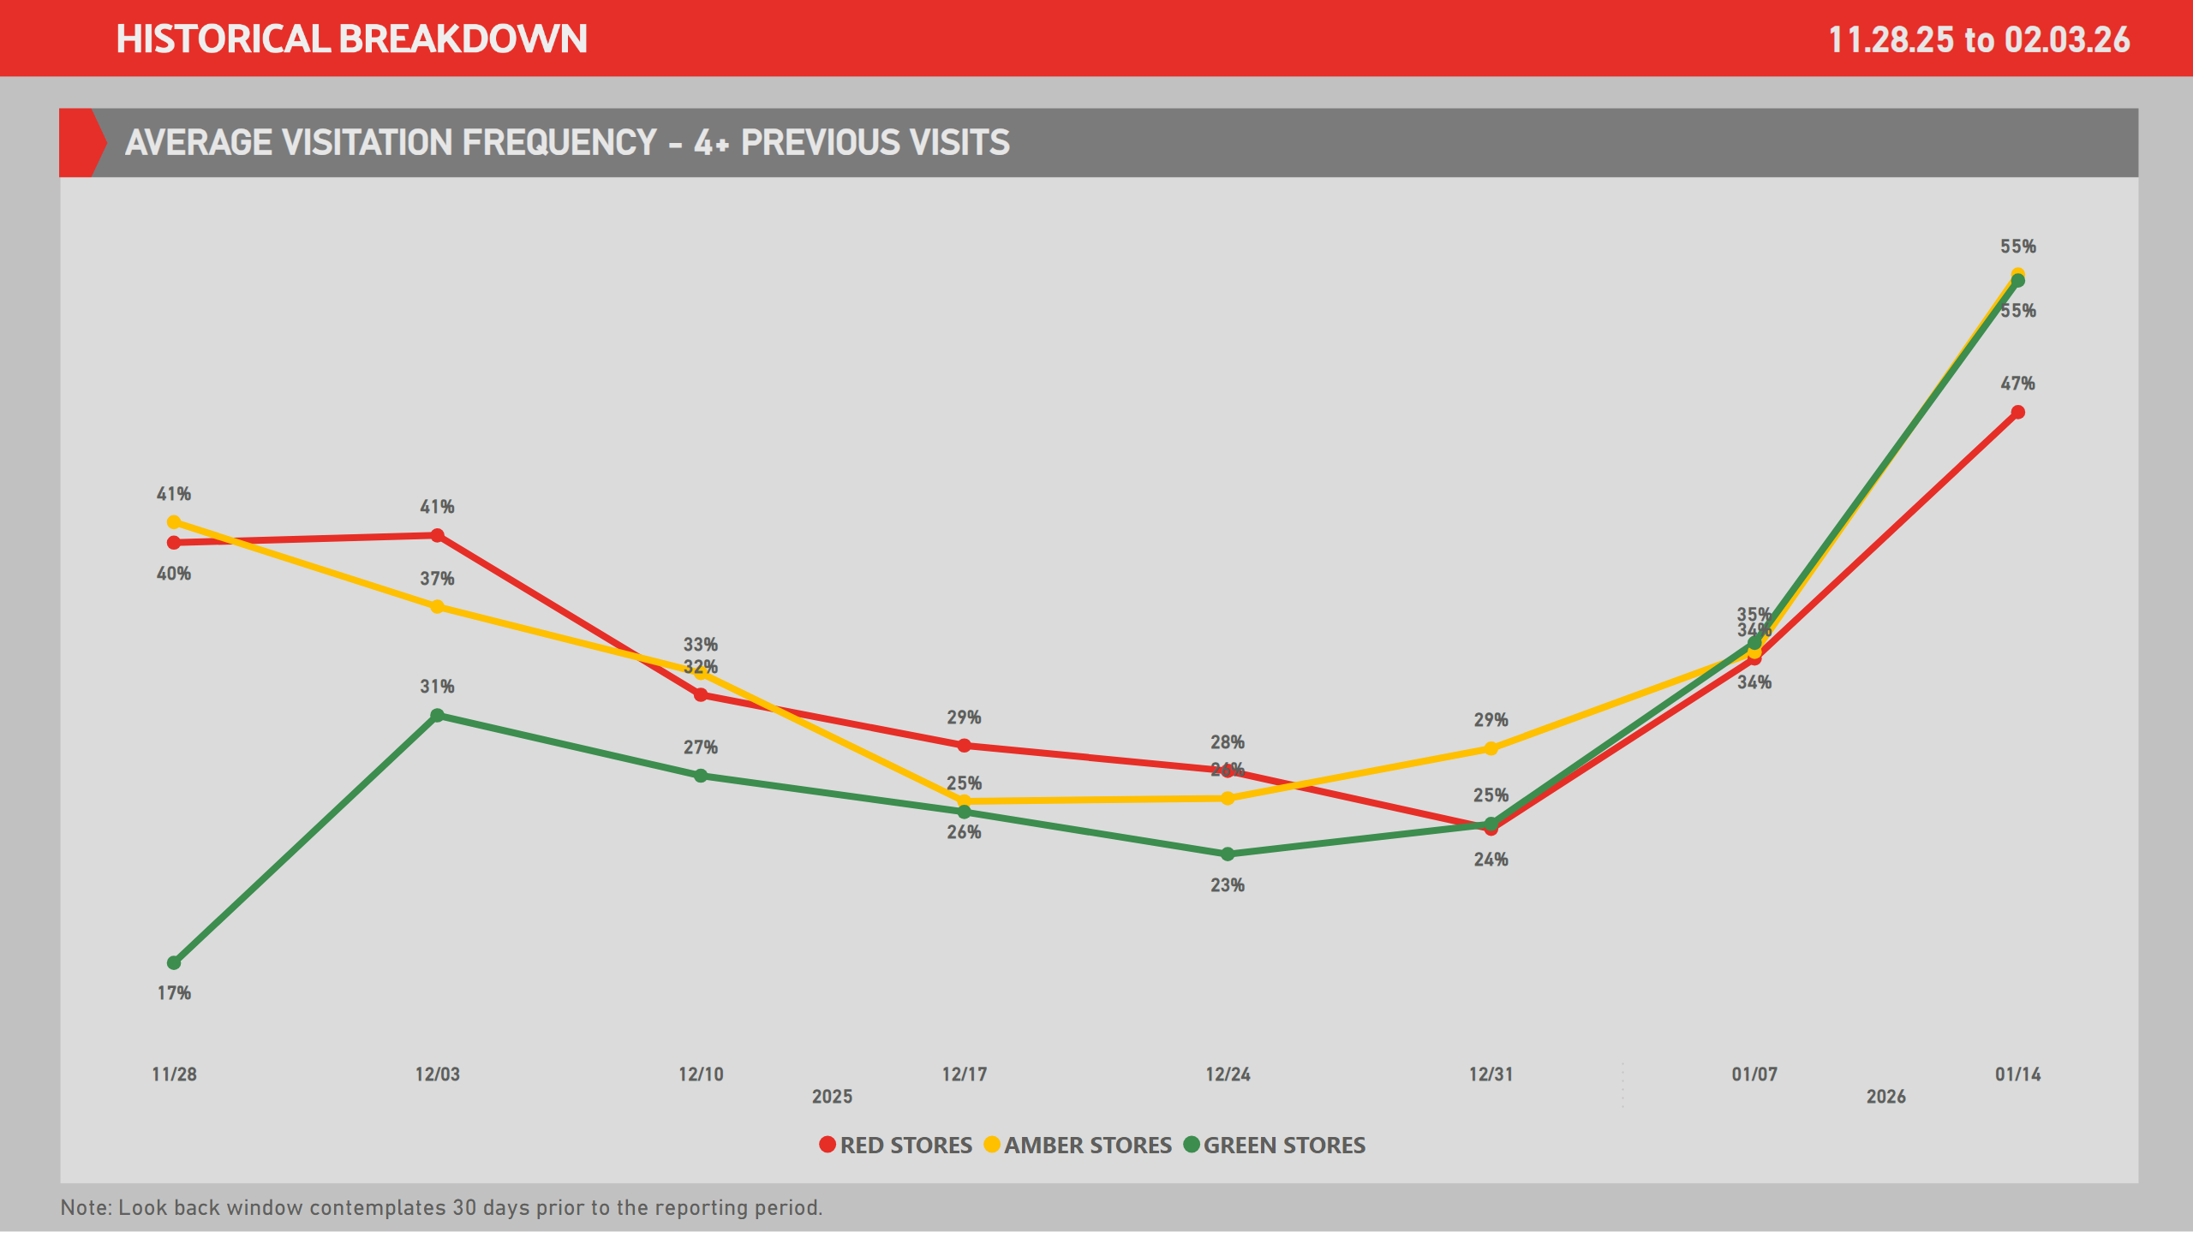
VF 4+
Notes:
lineChart
No alt text provided
lineChart
No alt text provided
Ad. Card - Demo Period
No alt text provided
slicer
No alt text provided
slicer
No alt text provided
Line Chart - Visits
No alt text provided
Ad. Card - Demo Period
No alt text provided
Ad. Card - Demo Period
No alt text provided

Slide 43
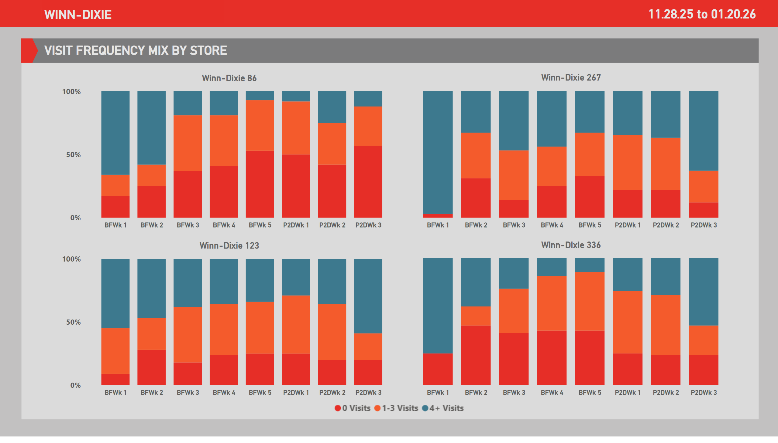
VFs - 1
Notes:
lineChart
No alt text provided
lineChart
No alt text provided
Ad. Card - Demo Period
No alt text provided
slicer
No alt text provided
slicer
No alt text provided
shape
No alt text provided
shape
No alt text provided
Ad. Card - Demo Period
No alt text provided
Ad. Card - Demo Period
No alt text provided
Winn-Dixie 86
No alt text provided
image
No alt text provided
Winn-Dixie 123
No alt text provided
Winn-Dixie 267
No alt text provided
Winn-Dixie 336
No alt text provided

Slide 44
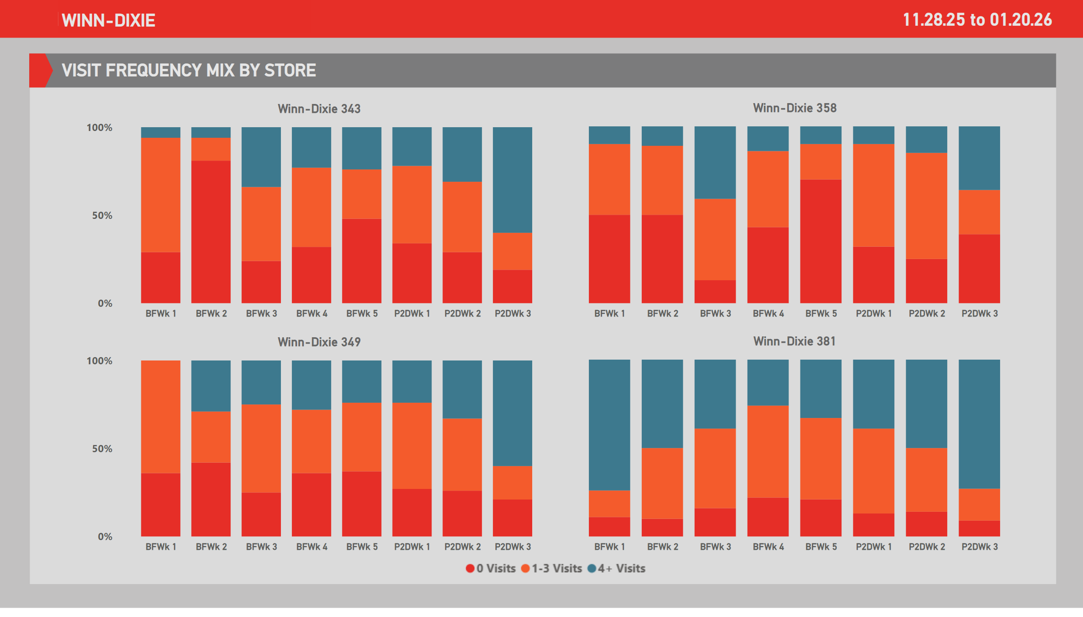
VFs - 2
Notes:
lineChart
No alt text provided
lineChart
No alt text provided
Ad. Card - Demo Period
No alt text provided
slicer
No alt text provided
slicer
No alt text provided
shape
No alt text provided
shape
No alt text provided
Ad. Card - Demo Period
No alt text provided
Ad. Card - Demo Period
No alt text provided
Winn-Dixie 343
No alt text provided
image
No alt text provided
Winn-Dixie 349
No alt text provided
Winn-Dixie 358
No alt text provided
Winn-Dixie 381
No alt text provided

Slide 45
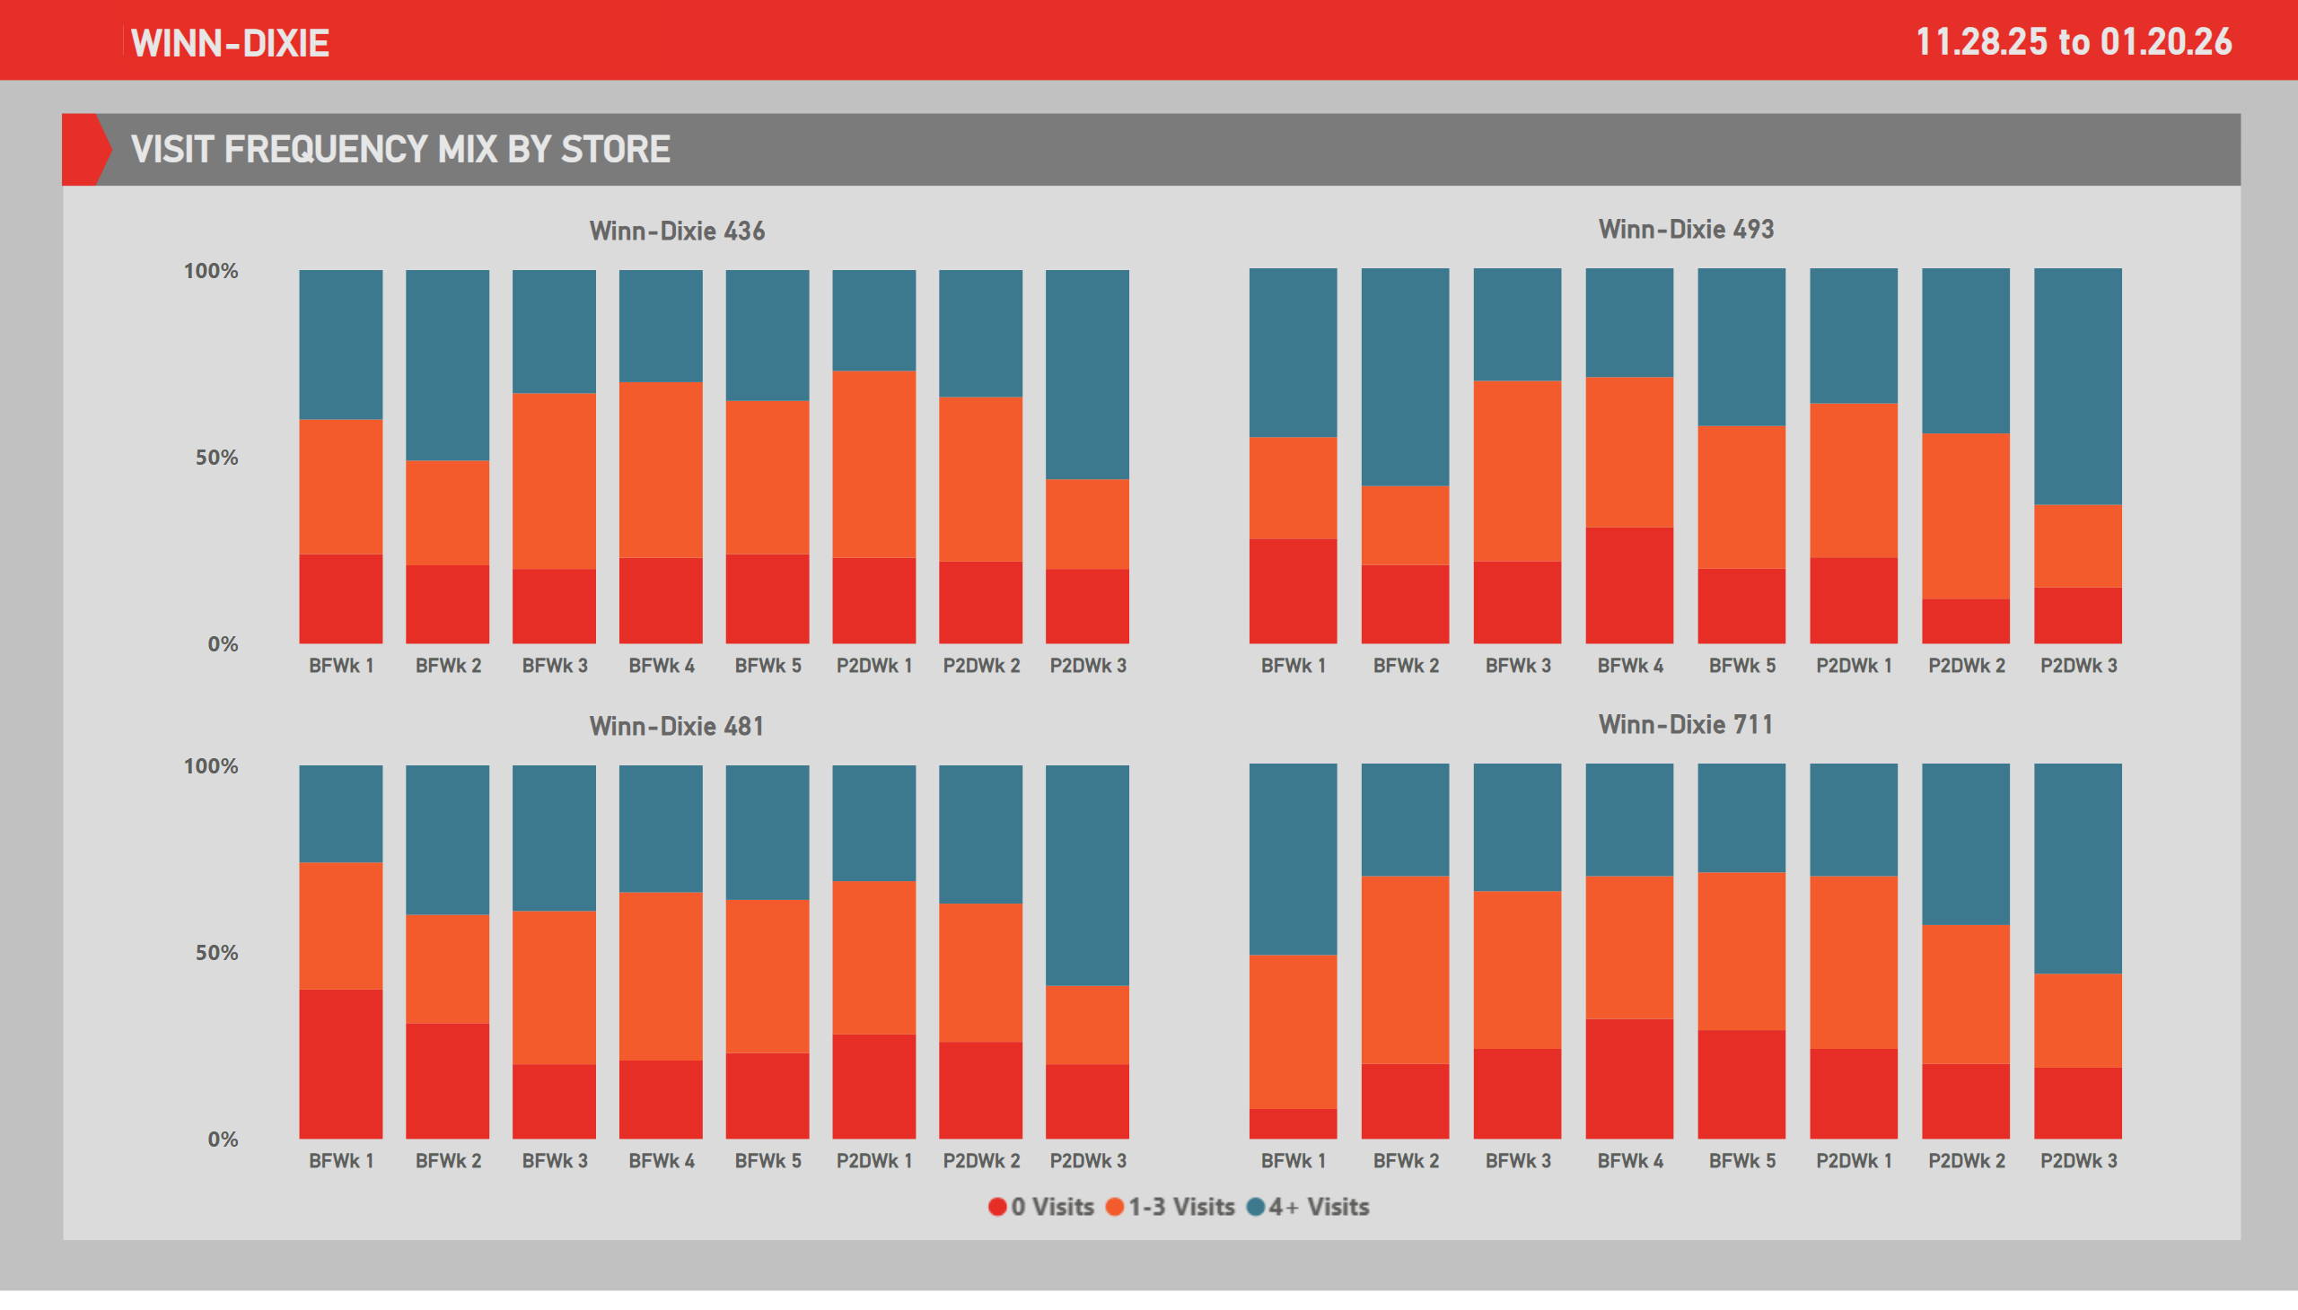
VFs - 3
Notes:
lineChart
No alt text provided
lineChart
No alt text provided
Ad. Card - Demo Period
No alt text provided
slicer
No alt text provided
slicer
No alt text provided
shape
No alt text provided
shape
No alt text provided
Ad. Card - Demo Period
No alt text provided
Ad. Card - Demo Period
No alt text provided
Winn-Dixie 436
No alt text provided
image
No alt text provided
Winn-Dixie 481
No alt text provided
Winn-Dixie 493
No alt text provided
Winn-Dixie 711
No alt text provided

Slide 46
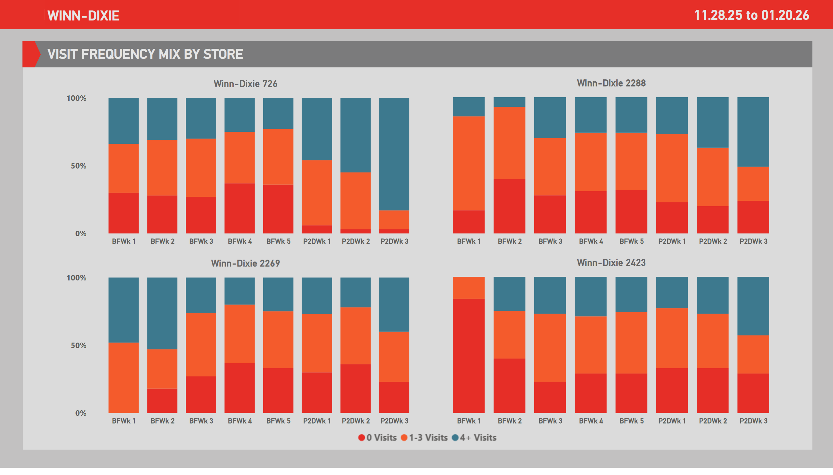
VFs - 4
Notes:
lineChart
No alt text provided
lineChart
No alt text provided
Ad. Card - Demo Period
No alt text provided
slicer
No alt text provided
slicer
No alt text provided
shape
No alt text provided
shape
No alt text provided
Ad. Card - Demo Period
No alt text provided
Ad. Card - Demo Period
No alt text provided
Winn-Dixie 726
No alt text provided
image
No alt text provided
Winn-Dixie 2269
No alt text provided
Winn-Dixie 2288
No alt text provided
Winn-Dixie 2423
No alt text provided

Slide 47
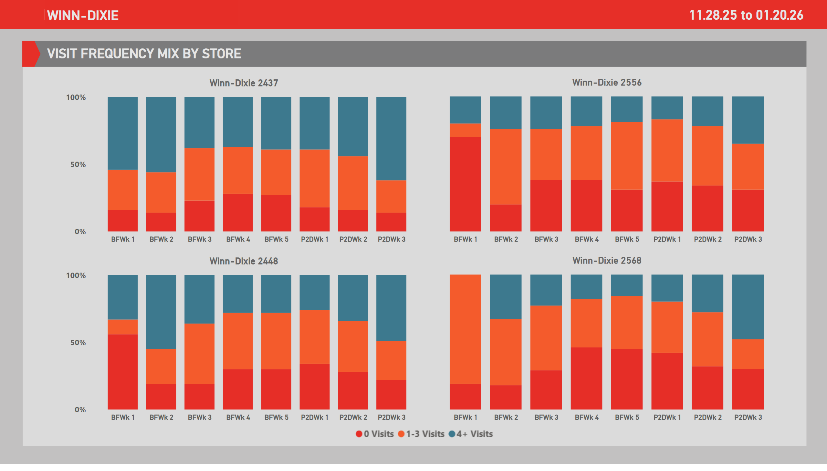
VFs - 5
Notes:
lineChart
No alt text provided
lineChart
No alt text provided
Ad. Card - Demo Period
No alt text provided
slicer
No alt text provided
slicer
No alt text provided
shape
No alt text provided
shape
No alt text provided
Ad. Card - Demo Period
No alt text provided
Ad. Card - Demo Period
No alt text provided
Winn-Dixie 2437
No alt text provided
image
No alt text provided
Winn-Dixie 2448
No alt text provided
Winn-Dixie 2556
No alt text provided
Winn-Dixie 2568
No alt text provided

